Slide 1

Financial Services
Notes:
Military OneSource logo. Call. 800-342-9647, Click. www.militaryonesource.mil, Connect. 24/7
Military OneSource is a Department of Defense-funded program providing comprehensive information on every aspect of military life at no cost to active duty, National Guard and Reserve Component service members, and their families. Information includes but is not limited to deployment, reunion and reintegration, relationship, grief, spouse employment and education, parenting and child care, and much more.
Military OneSource has policy and programmatic information, helpful resources, products, articles and tips on numerous topics related to military life. Services are available 24 hours a day by telephone and online. In addition to the website support, Military OneSource offers call center and online support for consultations on a number of issues such as spouse education and career opportunities, issues specific to families with a member with special needs, health coaching, financial support and resources.

Slide 2
General Eligibility
Active duty, National Guard and Reserve Component service members
Immediate family members
Coast Guard when activated with the Navy
Civilian Expeditionary Workforce
Notes:
Talking points
All active duty, National Guard and Reserve Component service members and their immediate family members, including spouses, children or anyone legally responsible for a service member’s children during a time of separation or deployment are eligible, regardless of activation.
Members of the Coast Guard are eligible when activated and deployed with the Navy.
Civilian Expeditionary Workforce members and their families are eligible while deployed and 90 days prior and 180 days post deployment.
Briefer notes
Individual Ready Reserve personnel are eligible.
Eligibility begins on the initial entrance date (that is, official entrance date into the military or date of delayed enlistment).
A person transitioning out of the military by way of honorable discharge or retirement is eligible up to 180 days.
In general, extended family is not eligible.
Ineligible Coast Guard members don’t qualify because they are under the Department of Homeland Security, not DoD.
Extended program eligibility reaches anyone who is Defense Enrollment Eligibility Reporting System – more commonly known as DEERS – eligible, including survivors (non-remarried spouses and children) of active duty, National Guard and Reserve Component service members regardless of activation status and lifetime eligibility through the Wounded Warrior Resources.

Slide 3
Private and Confidential
Privacy is protected
Your personal information will not be
  Provided to the military or chain of command
  Shared with family or friends
  Released to other agencies
Privacy Exceptions
Duty to warn
Suspected family maltreatment (domestic violence, child or elder abuse or neglect)
Harm to self or others
Illegal activity
Notes:
Talking points
Contacts with Military OneSource, whether by telephone, online or face-to-face non-medical counseling, are private.
Military OneSource ensures that personal information is secure and each user is treated confidentially and with respect, regardless of rank.
Neither service members nor their commanders are advised when a family member seeks Military OneSource non-medical counseling.
Privacy exceptions include suspected family maltreatment (for example, domestic violence, child or elder abuse or neglect), threats to harm self or others and illegal activities. In these cases, Military OneSource consultants have a duty to report to the appropriate military and civilian authorities. Face-to-face counselors are an extension of Military OneSource, so these reporting requirements apply to them as well.
Briefer notes
Substance or alcohol abuse is disclosed only when:
The service member self-reports drug abuse violating DoD regulations
The family member reports alcohol abuse related to domestic violence perpetrated by the service member or abuse or neglect of a child or special needs family member
Illegal activity has occurred (anything that breaks local, state or federal law will be reported under duty to warn, including illegal drug use, operating a vehicle under the influence, underage drinking, etc.)
Air Force personnel are read the following additional statement regarding the Personnel Reliability Program self-reporting requirement: “As a Personnel Reliability Program certified or administrative qualified member, you are responsible to self-notify your Certifying Official of any behavior or circumstances that may or could reduce effectiveness or capability in your job performance, safety or personal reliability. This includes your physical and mental wellness, dependability, or financial or legal concerns. You are also required to self-notify prior to any health care evaluation or treatment, whether military or private that you are a Personnel Reliability Program individual. Failure to make notification may cast doubt on your reliability and violates DoD and United States Air Force policy in DoD Regulation 5210.42.”

Slide 4

Range of Support
Community Resources & Referrals
Financial
Deployment
Health Coaching
Life Transitions
Relationships
Moving
Children & Youth
Libraries
Special Needs
Career & Education
Confidential Non-medical Counseling
Notes:
Talking points
Military OneSource offers support on a wide variety of topics. Many are interconnected, depending on the situation. For example, a family may call about relocation issues. Discussion of those issues may lead to assistance with new jobs, education counseling if the spouse is in the middle of school, etc.
Briefer notes
Presenter can share relevant examples about the many uses of Military OneSource.

Slide 5





Military OneSource:
Something for Everyone
Did you know Military OneSource has…
  Smart shopping tips (audio clips)
  Planning for your golden years (video)
  Connecting with your child (booklet)
  Dealing with your stress (downloadable)
  Disaster preparation (webinar)
Notes:
Talking points
Military OneSource has resources for everyone, no matter how long they have been affiliated with the military, and the resources are not just related to military life, but life in general.
Some of the resources that people tend not to know about are:
ePublications
Pet sitting information
Healthy meal planning tips
Links to outside agencies that provide emergency services
Locators to find schools and other resources
Explore Military OneSource to find out what else we have available.

Slide 6


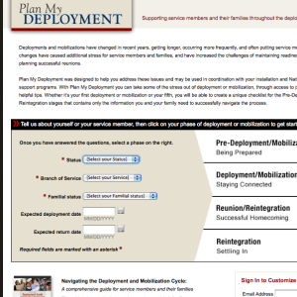
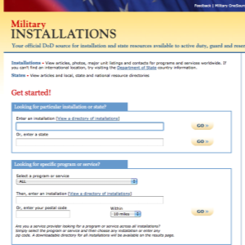
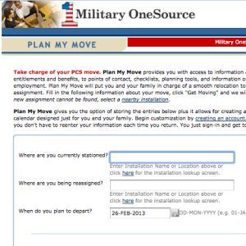

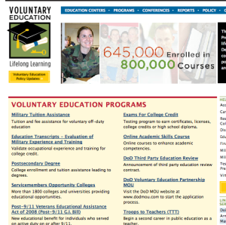
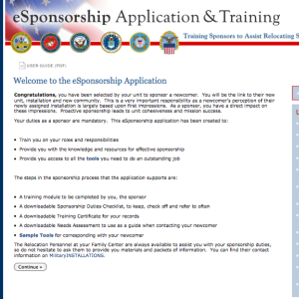
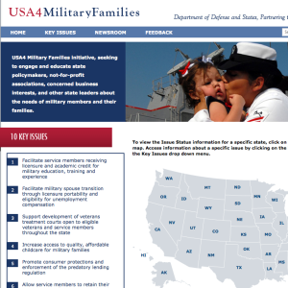
Our Websites
Notes:
Talking points
At the bottom of any Military OneSource page you will find links to Our Websites. These websites will further assist service members and family members with several things, including deployment, moving, locating installation services and much more!
Our websites include:
MilitaryINSTALLATIONS - MilitaryINSTALLATIONS allows you to search for programs and services on your installation.
Military Youth on the Move - This website is divided into kid, pre-teen, teenager and parent sections. You’ll find age appropriate information for your child to ease common struggles, including healthy living, safety, moving and new schools, money, and making new friends.
Military Spouse Employment Partnership Jobs Portal - The MSEP job portal is a job search engine specifically for military spouses. By entering the city, state and country of residence, spouses can browse through available jobs in the area. An advanced search allows spouses to search for a specific line of work.
Plan My Deployment - This tool helps service members and families understand what to expect and when throughout the deployment cycle. Entering the service member’s status, service branch, familial status, and expected deployment and return dates results in a personalized plan to help service members and families prepare for deployment.
Plan My Move - Similar to the personalized plans of Plan My Deployment, Plan My Move helps military service members and families create a timeline for a smooth move. Plug in your current duty station, new duty station and your departure date for your personalized timeline.
eSponsorship Training - If you have been assigned sponsorship of a newcomer, use your Common Access Card – known as the CAC – to access the eSponsorship application and training. You can also use this resource to communicate electronically and manage the sponsorship online.
MySECO - The MySECO website ensures spouses have 24/7 access to online education and career information, resources, tools and assessments. Using the tools and assessments, spouses can begin to explore their interests, skills, passions and personality type to determine the best fit for education and career choices and start to build a portable and meaningful career path.
USA4 Military Families - This website supports military families by explaining key issues that directly impact military service members and families. See the latest news or explore the key issues.
Voluntary Education - The Voluntary Education Portal offers guidance for anyone in the DoD community continuing their education. Information can be found about tuition assistance, the Post 9/11 G.I. Bill, Troops to Teachers, the Online Academic Skills Course, exams for college credit and much more.

Slide 7
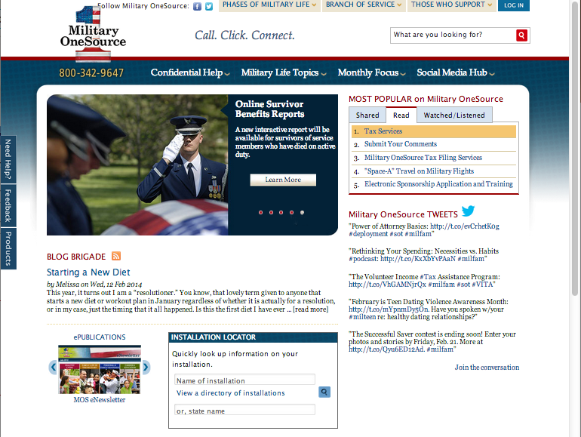
Military OneSource Homepage
Notes:
Talking points
There are two points of entry to the Military OneSource website the public and employee assistance program side. The public side offers a number of articles on military life topics and much more for service member, families, service providers, and leaders and requires no log in. If you are an eligible service or family member and would like to have access to confidential non-medical counseling, products and specialty consultations, select the log- in button at the top of this page. Note, that once you log into the employee assistance program side, you have left the public side of Military OneSource website.
The homepage offers quick access to:
Links to program pages
The most popular site content
An installation directory to help you find the resources closest to you
All of the available counseling options
Under the Military Life Topics tab, you will find links to each program page. Clicking on any link will take you to that program’s homepage where you will find a wealth of articles, resources and external links.
If you’re interested in the latest hot topics, browse the MOST POPULAR on Military OneSource menu in the top right-hand corner of the homepage. When something peaks your interest, simply click the link to read, watch or hear more.
The Installation Locator box in the middle of the page is your quick reference to all things about your current or soon-to-be installation. Simply fill in your installation’s name, state name or select your installation from the directory. This feature will also provide information on local support providers, like the Red Cross and Joint Force headquarters.
Hovering over the Confidential Help tab will immediately reveal contact phone numbers for instant contact or options for face-to-face, telephonic and online confidential non-medical counseling as well as confidential specialty consultation options (for example, adoption, health and wellness coaching, special needs and wounded warrior) and other services.

Slide 8
Military OneSource Homepage
Notes:
Talking points
Left menu:
The Need Help? tab takes users to options for confidential non-medical counseling services.
The Feedback tab navigates to a contact form for comments and suggestions, technical support or website accessibility.
The Products tab takes users to a menu of available products arranged by topic or product type, including audio and video tips, booklets, CDs and DVDs, resource guides and toolkits.
Top menu:
Hover over the Phases of Military Life tab to find helpful information no matter your current phase of military life, including new to the military, single life, career, Guard and reserve, deployment, family life, military leadership and retiring.
Click your branch of service under the Branch of Service tab for information specific to the Army, Marine Corps, Navy or Air Force.
The Those who Support tab leads to information specifically for community partners, leaders or command, and service providers.
The Log In tab takes users to a page that requires a username and password. While much of the information on Military OneSource is public, certain services, including confidential non-medical counseling, products and confidential specialty consultations are available only to eligible individuals through a secure log in.
Briefer notes
Note that the links for the ePublication Archives and MilitaryINSTALLATIONS, along with many more links, can be found at the bottom of the page.

Slide 9
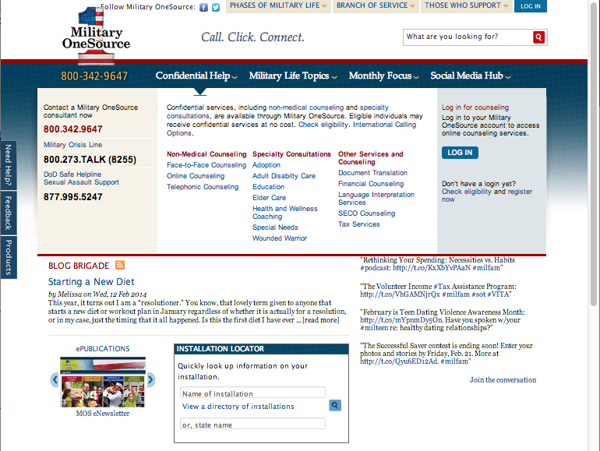
Confidential Help
Notes:
Talking points
Service members and family members can find confidential non-medical counseling information through the toll-free number, 800-342-9647 or through the links on any Military OneSource page by:
Hovering over the Confidential Help tab in the menu at the top of any page to see phone numbers for immediate support and the available counseling options offered through Military OneSource and a description of each, confidential non-medical counseling and specialty consultations as well as other services and counseling options.
Clicking the Military Life Topics tab in the menu at the top of any page to reveal a list of program pages. Selecting the non-medical counseling link will navigate to the program page for more information about Military OneSource confidential non-medical counseling options.
Clicking the Need Help? button in the left-hand margin of any Military OneSource page to be immediately taken to a simplified Counseling Services page.
Military OneSource confidential non-medical counseling:
Provides up to 12 confidential non-medical counseling sessions, per person, per issue at no cost. Note: financial counseling is unlimited.
Provides confidential short-term counseling to eligible individuals with such issues as: relocation, separation, reintegration, relationship issues, parenting skills, communication, anger management, grief, stress, deployment, life skills, coping skills, interpersonal skills and academic or occupational problems.
Is available via three different methods for convenience and generational preferences: face-to-face, telephonic and online. The Military OneSource consultant will assess your situation and help determine the most beneficial method. In most cases, referrals are made within 72 hours.
Does not provide or determine medical diagnosis. It is not a part of TRICARE, nor does it substitute for authorizations required for reimbursement under TRICARE.
Is not intended to be a part of a patient’s Medical Treatment Facility discharge plan or treatment of suicidal or homicidal thoughts, or Family Advocacy Program cases. It is not intended to address sexual assault, abuse, mental health conditions requiring in-patient hospitalizations and other behavioral concerns.
Military OneSource confidential specialty consultations:
Are available online or over the phone with specialists in various fields, including adoption, health and wellness coaching, special needs and wounded warrior.
Can be scheduled by calling Military OneSource at 800-342-9647 and asking for an appointment in one of the specialized areas.
Other Military OneSource services and counseling include:
Document translation
Financial counseling with certified financial planners
SECO counseling to help military spouses with career exploration, education, training and licensure, employment readiness, and career connections
Tax services
Briefer notes
Children are eligible for Military OneSource confidential non-medical face-to-face or telephonic counseling if:
A parent attends (for example, family counseling) with a child younger than 13
A parent brings a child between 13 and 18 to the individual counseling session
The child is 18 years or older

Slide 10
Financial Services
Financial Counseling
Budgeting and general financial management
Debt management
Housing counseling
Financial Planning
Investing
Retirement planning
Planning for college
TSP/401K/Pensions
Traditional and
ROTH IRAs
Assistance in selecting a certified financial planner in the local community
Tax questions and preparation
Notes:
Talking points
In addition to a wide variety of financial resources available through Military OneSource, financial counseling is also available at no cost to the service member or family member. Please call the toll-free number to set up a phone consultation with one of our personal financial counselors. Face-to-face financial counseling may also be available. A Military OneSource consultant can let you know about availability in your area.
You can talk with a certified financial counselor about budgeting and debt management. You can even get information on housing issues, such as pre-purchase, foreclosure prevention and reverse mortgages. Or, if you prefer, you can speak with a certified financial planner about everything from saving and investing to retirement planning. When it comes to financial support, Military OneSource has something for everyone, no matter your financial situation.
Briefer notes
All Military OneSource financial counselors are accredited financial counselors.
Military OneSource financial counselors are available to provide education and not to advise on options.
Affiliates are prohibited from making referrals to themselves or to another network affiliate for fee-based work as a result of a consultation. Also, sales of products or services to participants served through the financial counseling program are prohibited.

Slide 11
Guidelines for Military OneSource Financial Services
All financial services are conducted by one of the following:
Accredited financial counselors
Certified credit counselors
Chartered financial consultants
Military OneSource Certified Financial Planners:
Provide telephonic consultations that are approximately 45 minutes long
Are prohibited from making referrals to themselves, or to another fee-based work as a result of consultation
Are prohibited from making sales of products or services to participants served through the financial consultation program
Notes:
Talking points
These are the guidelines for Military OneSource financial services.
Financial services offered through Military OneSource are information and education, not advice.

Slide 12
Financial Counseling
Budgeting and general financial management
Debt management
  Establishing and restoring credit
  Loan consolidation
  Debt restructuring
Housing
  Home buying, mortgages and home equity loans
  Eviction and foreclosure prevention
Military-specific financial matters
Identity theft
Notes:
Talking points
Through these consultations, you can talk with a financial counselor for assistance with establishing a budget and answering questions related to general financial and debt management issues. Counselors can also assist you with information on housing issues, like pre-purchase, foreclosure prevention and eviction, as well as dealing with calls from collectors, identity theft or restoring credit.
In-person financial counseling is available at many CONUS locations through Military OneSource in partnership with the National Foundation for Credit Counseling.
Through coaching and education, counselors will assist service members and family members in creating a realistic plan with specific, manageable steps.
Military OneSource counselors are equipped to address military-specific financial matters, like credit issues impacting security clearances, money management before, during and after deployment, and coaching regarding military benefits (for example, SCRA, Thrift Savings Plans).
Briefer notes
Additional examples of counseling services could include information on loan consolidation, budgeting for child care, pre-tax plans (FSA, HSA, DCFSA), earned income tax credit and re-establishing credit after divorce.
All Military OneSource financial counselors are accredited financial counselors, certified credit counselors, certified financial planners or chartered financial consultants.
Service members may incur a cost for referrals to organizations providing long-term debt restructuring or consolidation programs.
Small business owners or those considering starting a business can contact Military OneSource for referrals to the Small Business Association.
Before briefing, confirm whether in-person financial counseling via the National Foundation for Credit Counseling is available in your state.

Slide 13
Financial Planning
Investment options
  Stocks, bonds, money markets, mutual funds and CDs
  Risk
  E-trading
Retirement
Savings plans
  TSP, 401K, 457, 403B, traditional, Roth IRA and pensions
New parents and children’s education
Locating local certified financial planners
Notes:
Talking points
Financial planning consultations are available to address issues such as investing, retirement planning, planning for college and questions regarding 401K, 403B (used by universities) TSP and IRA’s/Roth IRA’s, including the new TSP Roth IRA option.
Financial planners can provide information on investment vehicles such as stocks, bonds, mutual funds, etc., how they work and the risk associated with various investment options.
They may also provide assistance with retirement planning, including projecting a budget and Social Security income.
Additionally, financial planners can provide information on how to save for your children’s education.
Military OneSource can assist in locating local certified financial planners as well.

Slide 14
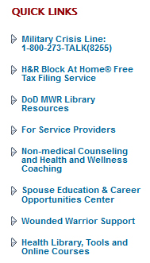
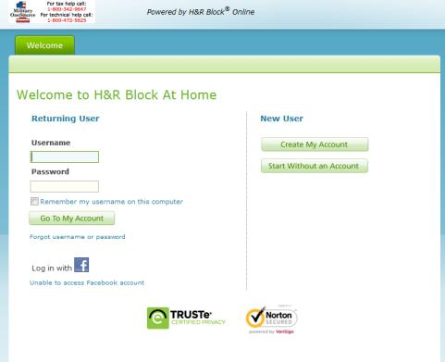
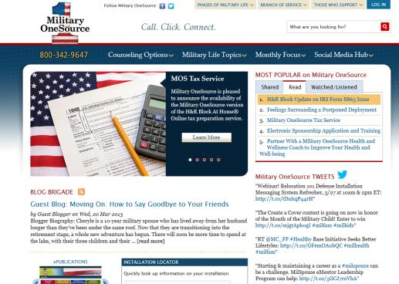
Tax Filing
Access tax filing software at no cost
Electronic filing of federal and up to three state returns
Notes:
Optional slide
For use during tax season.
Talking points
Generally beginning around the middle of January, Military OneSource provides tax-filing services and tax consultations to service members and family members throughout tax season at no cost.
Active duty, reservists and their legal dependents can file using the provided tax-filing software.
Participants can now e-file a federal and up to three state resident returns with the product.
Participants must use the link on Military OneSource to access the customized software. You will click Register from the Military OneSource page. You will then create a separate user ID and password. Keep in mind that those who access the public product directly through the provider website may incur charges. To access the link, you must be registered and logged in to www.MilitaryOneSource.mil.
Military OneSource tax consultants are available by phone and by e-mail to help you with personal federal tax-related questions and financial planning from 7 a.m.-11 p.m. EST daily by calling 800-342-9647.

Slide 15

Tax Consultation
  Federal tax filing requirements
  Allowable deductions
  Tax exemptions and tax credits
  IRA deductions
  W-2 and W-4 form
  Divorce taxation
  Capital gains
  Self-employment
  Filing extensions and deployment
Notes:
Talking points
Tax consultations are available for information and answers to questions on a wide variety of services, such as federal tax-filing requirements and special tax circumstances, including deployment, divorce or capital gains.
Specialized telephonic financial tax consultations are provided by a Military OneSource trained tax consultant.
Military OneSource will arrange a telephonic appointment with these financial tax consultants to provide information and education about federal tax issues.
NOTE: This service is available year round and separate from the Military OneSource tax program, which includes access electronic filing from January to June at no cost.

Slide 16

Financial Services Team - Who are They?
Military OneSource internal financial team
  Accredited financial counselors, certified credit counselors, certified financial planners or chartered financial consultants
National Foundation for Credit
Counseling partnership
Notes:
Talking points
Counselors are members of the accredited financial counselors, certified credit counselors, certified financial planners or chartered financial consultants – which is the same as installation personal financial managers.
Military OneSource also has a partnership with the National Foundation for Credit Counseling to provide face-to-face, telephonic and online financial counseling.
The National Foundation for Credit Counseling – a non-profit national agency – provides financial education and counseling services at hundreds of local offices nationwide.
Military OneSource must arrange for you to meet with a National Foundation for Credit Counseling financial consultant in your community in order for you to receive the service at no cost.
Briefer notes
Before briefing, confirm whether in-person financial counseling via the National Foundation for Credit Counseling is available in your state.
Entering into a debt management program does incur a nominal fee from the National Foundation for Credit Counseling agency for ongoing management of the plan.

Slide 17
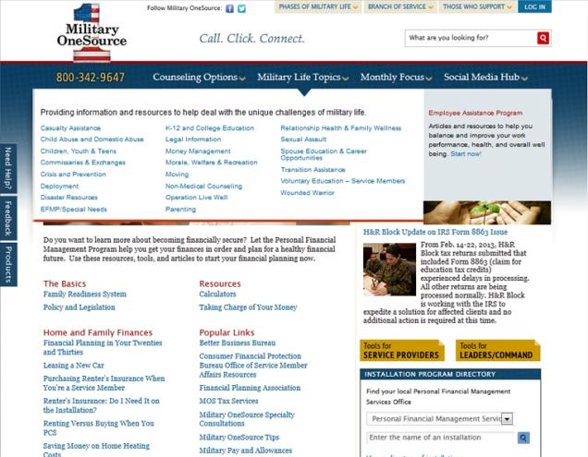
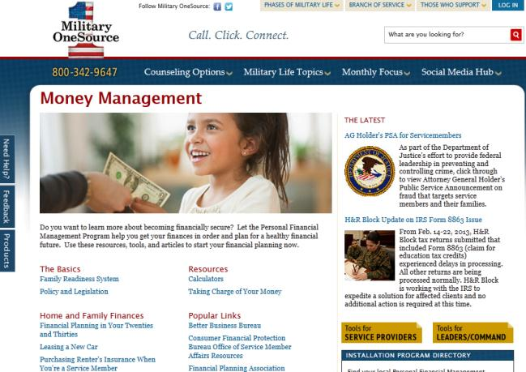
Accessing Financial Materials
Hover over the Military Life Topics tab, and click the Money Management link.
Notes:
Talking points
The Military Life Topics tab can be found at the top of any Military OneSource page.
After clicking the Money Management Link, you’ll see links to articles and resources on various financial topics.

Slide 18

Financial Tools
Financial calculators
  Home finance
  Personal finance
    Car buying
    Saving for college
  Retirement calculators
  Investment (savings and earnings calculator)
Financial audio and video tips
Money management Podcasts
Notes:
Talking points
Military OneSource offers a wide range of financial tools available through the website, including financial calculators and a long list of money management Podcasts.

Slide 19
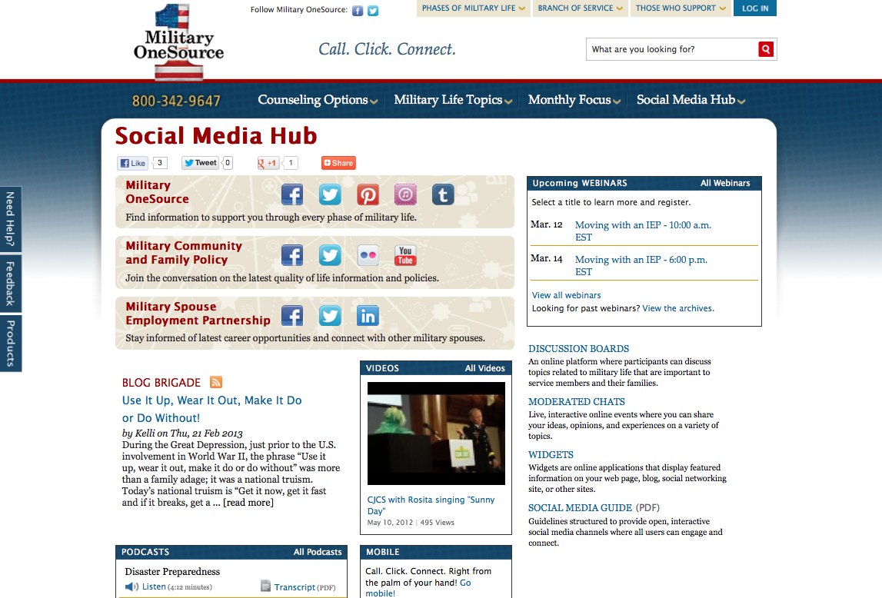
Social Media Hub
Notes:
Talking points
Access to Military OneSource social media outlets is conveniently located on the homepage.
View the Twitter feed on the right-hand side of the page.
Follow the link to the Military OneSource Facebook page.
The latest Blog Brigade entry can be found just below the image box, in the middle of the page.
More complete access to social media can be found by hovering over the Social Media Hub tab at the top of the homepage. Here you’ll find links to:
Social media hub
Blog Brigade
Discussion boards
Podcasts
Webinars
Widgets
Videos
Briefer notes
Explain some of the social media offerings and remind audience of upcoming webinars.

Slide 20
Spouse Education and
Career Opportunities Program
Military Spouse Career Center at Military OneSource
Spouse Education and Career Opportunities comprehensive counseling service available to ALL military spouses.
Career exploration and discovery
Education, training and state licensing/credentialing requirements
Employment readiness
Career connections
https://www.militaryonesource.mil/ and https://myseco.militaryonesource.mil
My Career Advancement Accounts Scholarship Program
Financial assistance for spouses of Service members in pay-grades of E1-E5, O1-O2 and W1-W2
Up to $4,000 for education/training and license/credential in a portable career
Financial assistance provided to more than 43,000 spouses in fiscal year 2012
https://aiportal.acc.af.mil/mycaa/
Military Spouse Employment Partnership
Web-enabled employment and career partnership connect military spouses with vetted Fortune 500 PLUS employers – 231 corporate partners
Partners’ Statements of Support to increase employment, provide career promotion opportunities and ensure pay equity for military spouses
Spouse Ambassador Network
https://msepjobs.militaryonesource.mil/

Slide 21
















Online Library Resources
Audio books, e-books, research, tutoring, exam prep, résumé builder and more!
Image of various online library resource logos
Notes:
Talking points
Military One Source provides electronic library resources at no cost 24 hours a day, 7 days a week and 365 days a year. Note for Guard, reserve and remote location audiences: This is a particularly helpful benefit for those who may not have physical access to an installation library.
The online resources are provided by the DoD Morale, Welfare and Recreation Library program and can be accessed through the Morale, Welfare and Recreation link under the Military Life Topics tab.
Briefer notes
Discuss some of the information that is available using the selected widgets on the slide. Not all resources available are represented on the slide.
Peterson’s Education Resource Center provides study guides and practice tests for SAT, ACT, CLEP, ASVAB, certifications and more, as well as help with scholarships and the admissions process.
Morningstar Investment Research Center offers information and advice on mutual funds, stocks, exchange traded funds and companies.
Career Transitions helps users find job announcements, write a resume, map military experience to civilian jobs, write a cover letter, access career interests and participate in an interview simulation.
Master File Premier and Academic One Source links to scholarly and informational full-text journal articles, including extensive coverage of the sciences, technology, medicine, the arts, theology, literature, history and culture.
Auto Repair Reference Center offers complete automotive repair manuals, 1954 to current.
Heritage Quest offers an essential collection of unique materials for both genealogical and historical researchers with coverage dating back to the late 1700s.
Kids InfoBits is designed especially for students in kindergarten through grade five.
Culture Grams allows users to experience the world and its people through detailed cultural information on more than 200 countries through both adult and child interfaces.
One Click Digital and EBSCO eBooks Collection offers downloadable audio files and eBooks for checkout.
TumbleBook Library is an online collection of eBooks for reading, listening and playing games for ages 4-12.
Safari Books Online is an eReference library with thousands of business and information technology books.
Tutor.com is a one-on-one online live homework help site. See registration site for eligibility.
NewsBank offers electronic editions of the Army, Air Force, Marine Corps, Navy, and Federal Times and other Defense and Government publications.
Military and Intelligence Database is a custom collection of more than 500 journals, articles, books, and magazines with military and government relevance.

Slide 22
Access
You can expect:
24/7/365 worldwide access
Master’s-level consultants to answer your questions
Objective, experienced and caring people
Up-to-date and useful information
No cost
A commitment to quality
Toll-Free telephone
800-342-9647
MilitaryOneSource.mil
m.MilitaryOneSource.mil
Email your questions
to a consultant
Interaction with trained
outreach professionals
Notes:
Talking points
Military OneSource is available 24/7/365, in other words, when you need us, we are there.
You can call our toll-free number to talk to a trained master’s-level consultant who can offer confidential support and up-to-date practical solutions or appropriate referrals.
Or, access our website and browse through everything the site has to offer, including webinars, newsletters and all of the other support discussed during this presentation.
Even on the go, Military OneSource is at your fingertips. The mobile site allows you to reach all of the resources of the traditional Military OneSource website no matter where you are.
Access to some information and services, including confidential non-medical counseling, requires you to log-in. To do so, you will need to create your own user name and password.
You also have the option to email a consultant your question. The consultant will research your request and get back to you. If your request is urgent or time sensitive, you will want to call the toll-free number to speak with a live consultant.
All Military OneSource services and materials are available at no cost to service members and their families.
Additionally, Military OneSource is constantly looking for ways to improve the service, and values all feedback. We conduct surveys asking for information on your experience. The 12-question survey will periodically appear on the website, or you can access it direct via the Contact Us link.
For a situation where the service did not meet the expectation, there is a customer recovery process in place. Each complaint is documented and taken very seriously. All departments are notified to ensure proper training and actions are taken to immediately respond to the breakdown. Rest assured that Military OneSource truly cares for, and is committed to service members and families and strives for 100 percent customer satisfaction.

Slide 23
Questions?
Notes:
Talking points
Does anyone have any questions?
Let them know how long you will be around after the presentation and where they can find you if they think of a question they would like to ask later on.
Direct additional questions to the Military OneSource call center at 800-342-9647.

Slide 24

Call. Click. Connect.
800-342-9647 MilitaryOneSource.mil
Notes:
Briefer notes
Point out the contact phone number and website to audience members and remind them to direct additional questions and concerns to a Military OneSource consultant through the call center.

