Slide 1

Service Providers
Notes:
Military OneSource logo. Call. 800-342-9647, Click. www.militaryonesource.mil, Connect. 24/7
Military OneSource is a Department of Defense-funded program providing comprehensive information on every aspect of military life at no cost to active duty, National Guard and Reserve Component service members, and their families. Information includes, but is not limited to deployment, reunion and reintegration, relationship, grief, spouse employment and education, parenting and child care, and much more.
Military OneSource has policy and programmatic information, helpful resources, products, articles and tips on numerous topics related to military life. Services are available 24 hours a day by telephone and online. In addition to the website support, Military OneSource offers call center and online support for consultations on a number of issues such as spouse education and career opportunities, issues specific to families with a member with special needs, health coaching, financial support and resources.

Slide 2
General Eligibility
Active duty, National Guard and Reserve Component service members
Immediate family members
Coast Guard when activated with the Navy
Civilian Expeditionary Workforce
Notes:
Talking points
All active duty, National Guard and Reserve Component service members and their immediate family members, including spouses, children or anyone legally responsible for a service member’s children during a time of separation or deployment are eligible, regardless of activation.
Members of the Coast Guard are eligible when activated and deployed with the Navy.
Civilian Expeditionary Workforce members and their families are eligible while deployed and 90 days prior and 180 days post deployment.
Briefer notes
Individual Ready Reserve personnel are eligible.
Eligibility begins on the initial entrance date (that is, official entrance date into the military or date of delayed enlistment).
A person transitioning out of the military by way of honorable discharge or retirement is eligible up to 180 days.
In general, extended family is not eligible.
Ineligible Coast Guard members don’t qualify because they are under the Department of Homeland Security, not DoD.
Extended program eligibility reaches anyone who is Defense Enrollment Eligibility Reporting System – more commonly known as DEERS – eligible, including survivors (non-remarried spouses and children) of active duty, National Guard and Reserve Component service members regardless of activation status and lifetime eligibility through the Wounded Warrior Resources.

Slide 3
Private and Confidential
Privacy is protected
Your personal information will not be
  Provided to the military or chain of command
  Shared with family or friends
  Released to other agencies
Privacy Exceptions
Duty to warn
Suspected family maltreatment (domestic violence, child or elder abuse/neglect)
Harm to self or others
Illegal activity
Notes:
Talking points
Contacts with Military OneSource, whether by telephone, online or face-to-face non-medical counseling, are private.
Military OneSource ensures that personal information is secure and each user is treated confidentially and with respect, regardless of rank.
Neither service members nor their commanders are advised when a family member seeks Military OneSource non-medical counseling.
Privacy exceptions include suspected family maltreatment (for example, domestic violence, child or elder abuse or neglect), threats to harm self or others and illegal activities. In these cases, Military OneSource consultants have a duty to report to the appropriate military and civilian authorities. Face-to-face counselors are an extension of Military OneSource, so these reporting requirements apply to them as well.
Briefer notes
Substance or alcohol abuse is disclosed only when:
The service member self-reports drug abuse violating DoD regulations
The family member reports alcohol abuse related to domestic violence perpetrated by the service member or abuse or neglect of a child or special needs family member
Illegal activity has occurred (anything that breaks local, state or federal law will be reported under duty to warn, including illegal drug use, operating a vehicle under the influence, underage drinking, etc.)
Air Force personnel are read the following additional statement regarding the Personnel Reliability Program self-reporting requirement: “As a Personnel Reliability Program certified or administrative qualified member, you are responsible to self-notify your Certifying Official of any behavior or circumstances that may or could reduce effectiveness or capability in your job performance, safety or personal reliability. This includes your physical and mental wellness, dependability, or financial or legal concerns. You are also required to self-notify prior to any health care evaluation or treatment, whether military or private that you are a PRP individual. Failure to make notification may cast doubt on your reliability and violates DoD and United States Air Force policy in DoD Regulation 5210.42.”

Slide 4

Range of Support
Community Resources & Referrals
Financial
Deployment
Health Coaching
Life Transitions
Relationships
Moving
Children & Youth
Libraries
Special Needs
Career & Education
Confidential Non-medical Counseling
Notes:
Talking points
Military OneSource offers support on a wide variety of topics. Many are interconnected, depending on the situation. For example, a family may call about relocation issues. Discussion of those issues may lead to assistance with new jobs, education counseling if the spouse is in the middle of school, etc.
Briefer notes
Presenter can share relevant examples about the many uses of Military OneSource.

Slide 5





Military OneSource:
Something for Everyone
Did you know Military OneSource has…
  Smart shopping tips (audio clips)
  Planning for your golden years (video)
  Connecting with your child (booklet)
  Dealing with your stress (downloadable)
  Disaster preparation (webinar)
Notes:
Talking points
Military OneSource has resources for everyone, no matter how long they have been affiliated with the military, and the resources are not just related to military life, but life in general.
Some of the resources that people tend not to know about are:
ePublications
Pet sitting information
Healthy meal planning tips
Links to outside agencies that provide emergency services
Locators to find schools and other resources
Explore Military OneSource to find out what else we have available.

Slide 6


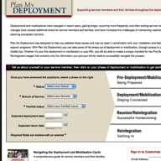
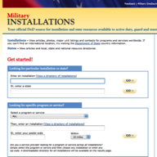
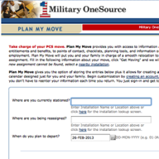


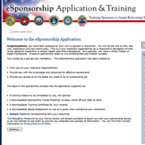
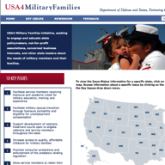
Our Websites
Notes:
Talking points
At the bottom of any Military OneSource page you will find links to Our Websites. These websites will further assist service members and family members with several things, including deployment, moving, locating installation services and much more!
Our websites include:
MilitaryINSTALLATIONS - MilitaryINSTALLATIONS allows you to search for programs and services on your installation.
Military Youth on the Move - This website is divided into kid, pre-teen, teenager and parent sections. You’ll find age appropriate information for your child to ease common struggles, including healthy living, safety, moving and new schools, money, and making new friends.
Military Spouse Employment Partnership Jobs Portal - The MSEP job portal is a job search engine specifically for military spouses. By entering the city, state and country of residence, spouses can browse through available jobs in the area. An advanced search allows spouses to search for a specific line of work.
Plan My Deployment - This tool helps service members and families understand what to expect and when throughout the deployment cycle. Entering the service member’s status, service branch, familial status, and expected deployment and return dates results in a personalized plan to help service members and families prepare for deployment.
Plan My Move - Similar to the personalized plans of Plan My Deployment, Plan My Move helps military service members and families create a timeline for a smooth move. Plug in your current duty station, new duty station and your departure date for your personalized timeline.
eSponsorship Training - If you have been assigned sponsorship of a newcomer, use your Common Access Card – known as the CAC – to access the eSponsorship application and training. You can also use this resource to communicate electronically and manage the sponsorship online.
MySECO - The MySECO website ensures spouses have 24/7 access to online education and career information, resources, tools and assessments. Using the tools and assessments, spouses can begin to explore their interests, skills, passions and personality type to determine the best fit for education and career choices and start to build a portable and meaningful career path.
USA4 Military Families - This website supports military families by explaining key issues that directly impact military service members and families. See the latest news or explore the key issues.
Voluntary Education - The Voluntary Education Portal offers guidance for anyone in the DoD community continuing their education. Information can be found about tuition assistance, the Post 9/11 G.I. Bill, Troops to Teachers, the Online Academic Skills Course, exams for college credit and much more.

Slide 7
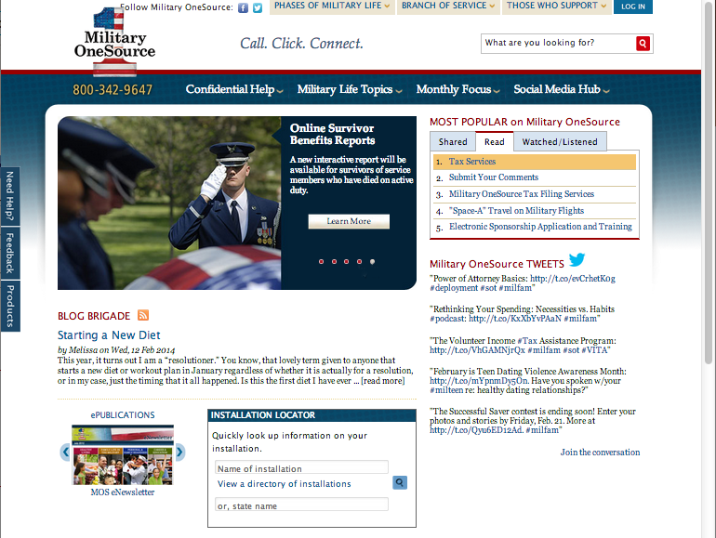
Military OneSource Homepage
Notes:
Talking points
There are two points of entry to the Military OneSource website the public and employee assistance program side. The public side offers a number of articles on military life topics and much more for service member, families, service providers, and leaders and requires no log in. If you are an eligible service or family member and would like to have access to confidential non-medical counseling, products and specialty consultations, select the log- in button at the top of this page. Note, that once you log into the employee assistance program side, you have left the public side of Military OneSource website.
The homepage offers quick access to:
Links to program pages
The most popular site content
An installation directory to help you find the resources closest to you
All of the available counseling options
Under the Military Life Topics tab, you will find links to each program page. Clicking on any link will take you to that program’s homepage where you will find a wealth of articles, resources and external links.
If you’re interested in the latest hot topics, browse the MOST POPULAR on Military OneSource menu in the top right-hand corner of the homepage. When something peaks your interest, simply click the link to read, watch or hear more.
The Installation Locator box in the middle of the page is your quick reference to all things about your current or soon-to-be installation. Simply fill in your installation’s name, state name or select your installation from the directory. This feature will also provide information on local support providers, like the Red Cross and Joint Force headquarters.
Hovering over the Confidential Help tab will immediately reveal contact phone numbers for instant contact or options for face-to-face, telephonic and online confidential non-medical counseling as well as confidential specialty consultation options (for example, adoption, health and wellness coaching, special needs and wounded warrior) and other services.

Slide 8
Military OneSource Homepage
Notes:
Talking points
Left menu:
The Need Help? tab takes users to options for confidential non-medical counseling services.
The Feedback tab navigates to a contact form for comments and suggestions, technical support or website accessibility.
The Products tab takes users to a menu of available products arranged by topic or product type, including audio and video tips, booklets, CDs and DVDs, resource guides and toolkits.
Top menu:
Hover over the Phases of Military Life tab to find helpful information no matter your current phase of military life, including new to the military, single life, career, Guard and reserve, deployment, family life, military leadership and retiring.
Click your branch of service under the Branch of Service tab for information specific to the Army, Marine Corps, Navy or Air Force.
The Those who Support tab leads to information specifically for community partners, leaders or command, and service providers.
The Log In tab takes users to a page that requires a username and password. While much of the information on Military OneSource is public, certain services, including confidential non-medical counseling, products and confidential specialty consultations are available only to eligible individuals through a secure log in.
Briefer notes
Note that the links for the ePublication Archives and MilitaryINSTALLATIONS, along with many more links, can be found at the bottom of the page.

Slide 9
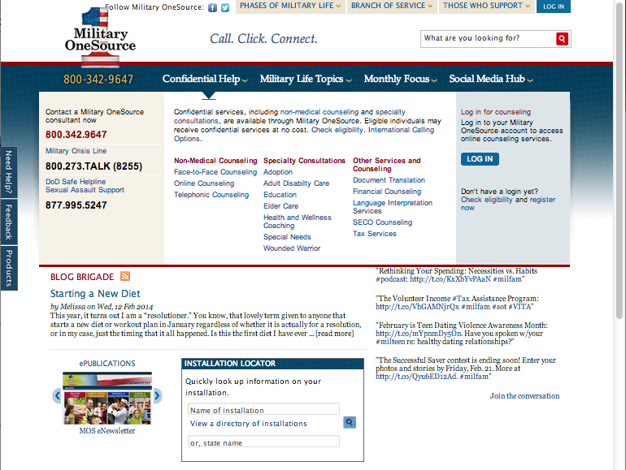
Confidential Help
Notes:
Talking points
Service members and family members can find confidential non-medical counseling information through the toll-free number, 800-342-9647 or through the links on any Military OneSource page by:
Hovering over the Confidential Help tab in the menu at the top of any page to see phone numbers for immediate support and the available counseling options offered through Military OneSource and a description of each, confidential non-medical counseling and specialty consultations as well as other services and counseling options.
Clicking the Military Life Topics tab in the menu at the top of any page to reveal a list of program pages. Selecting the non-medical counseling link will navigate to the program page for more information about Military OneSource confidential non-medical counseling options.
Clicking the Need Help? button in the left-hand margin of any Military OneSource page to be immediately taken to a simplified Counseling Services page.
Military OneSource confidential non-medical counseling:
Provides up to 12 confidential non-medical counseling sessions, per person, per issue at no cost. Note: financial counseling is unlimited.
Provides confidential short-term counseling to eligible individuals with such issues as: relocation, separation, reintegration, relationship issues, parenting skills, communication, anger management, grief, stress, deployment, life skills, coping skills, interpersonal skills and academic or occupational problems.
Is available via three different methods for convenience and generational preferences: face-to-face, telephonic and online. The Military OneSource consultant will assess your situation and help determine the most beneficial method. In most cases, referrals are made within 72 hours.
Does not provide or determine medical diagnosis. It is not a part of TRICARE, nor does it substitute for authorizations required for reimbursement under TRICARE.
Is not intended to be a part of a patient’s Medical Treatment Facility discharge plan or treatment of suicidal or homicidal thoughts, or Family Advocacy Program cases. It is not intended to address sexual assault, abuse, mental health conditions requiring in-patient hospitalizations and other behavioral concerns.
Military OneSource confidential specialty consultations:
Are available online or over the phone with specialists in various fields, including adoption, health and wellness coaching, special needs and wounded warrior.
Can be scheduled by calling Military OneSource at 800-342-9647 and asking for an appointment in one of the specialized areas.
Other Military OneSource services and counseling include:
Document translation
Financial counseling with certified financial planners
SECO counseling to help military spouses with career exploration, education, training and licensure, employment readiness, and career connections
Tax services
Briefer notes
Children are eligible for Military OneSource confidential non-medical face-to-face or telephonic counseling if:
A parent attends (for example, family counseling) with a child younger than 13
A parent brings a child between 13 and 18 to the individual counseling session
The child is 18 years or older

Slide 10
Spouse Education and
Career Opportunities Program
Military Spouse Career Center at Military OneSource
Spouse Education and Career Opportunities comprehensive counseling service available to ALL military spouses.
Career exploration and discovery
Education, training and state licensing/credentialing requirements
Employment readiness
Career connections
https://www.militaryonesource.mil/ and https://myseco.militaryonesource.mil
My Career Advancement Accounts Scholarship Program
Financial assistance for spouses of Service members in pay-grades of E1-E5, O1-O2 and W1-W2
Up to $4,000 for education/training and license/credential in a portable career
Financial assistance provided to more than 43,000 spouses in fiscal year 2012
https://aiportal.acc.af.mil/mycaa/
Military Spouse Employment Partnership
Web-enabled employment and career partnership connect military spouses with vetted Fortune 500 PLUS employers – 231 corporate partners
Partners’ Statements of Support to increase employment, provide career promotion opportunities and ensure pay equity for military spouses
Spouse Ambassador Network
https://msepjobs.militaryonesource.mil/

Slide 11
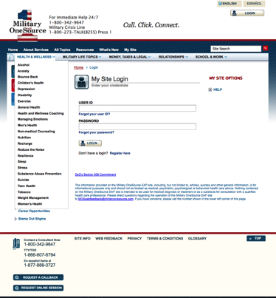
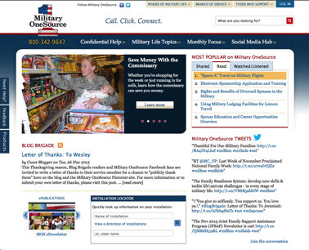
Login
Notes:
Talking points
Log in with existing credentials or select Register here. If you have a username and password, select option to update your profile. When registering or updating your profile, be sure to select Service Provider as your role.
To register:
Identify the branch of service and component you support.
Identify the component that you support, your role (service provider) and the location you serve.
Create a username and password and enter your email address.
Check the box stating you are eligible to access Military OneSource. All service providers are eligible to access Military OneSource.
Briefer notes
If the service provider supports more than one branch or component, have them select the primary one that they support.

Slide 12
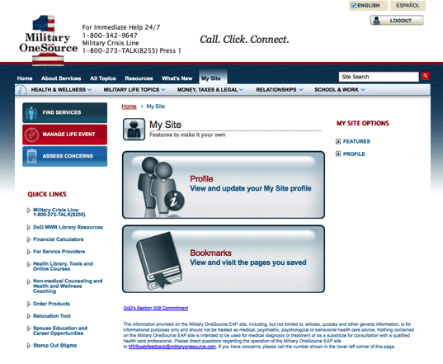
Accessing Service Provider Home
Notes:
Talking points
This is the homepage for the Military OneSource employee assistance program website. Select the For Service Providers link under quick links.

Slide 13
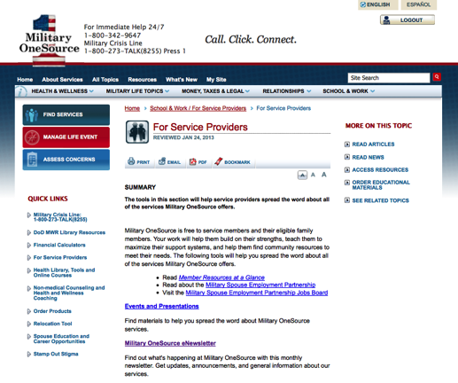
Service Provider Home
Notes:
Talking points
This is the service provider main page. Note, additional pages can be found by clicking on the hyperlinks or viewing the items in the right toolbar, MORE ON THIS TOPIC.
The service provider homepage provides access to the monthly communication calendar, events and presentations, the Military OneSource newsletter, and orderable and printable materials.

Slide 14
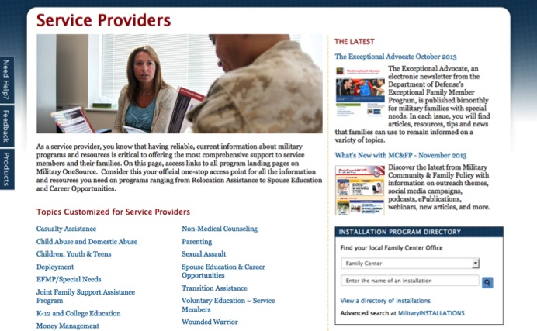
Service Provider Resources
Notes:
Talking points
Access to current resources is an essential part of serving the military community.
By selecting Service Providers from the drop-down menu under Those Who Support, you’ll reach a page that can help you in your service of the military community.
You’ll be able to find information by topic (for example, deployment, parenting or education) and you can find valuable resources, including quick reference guides and downloadable fliers.
On the right-hand side of the page you can conveniently navigate to some of the latest publications that Military OneSource offers, including the current edition of What’s New with MC&FP.
Briefer notes
From this page, service providers can also subscribe to the RSS feed for the most current updates and search programs by installation in order to better support those in their local military community.

Slide 15

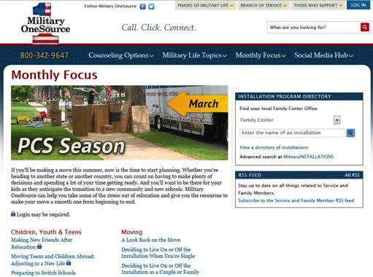
Monthly Focus
Notes:
Talking points
Let our themes provide the foundation for your monthly family readiness focus. By combining existing local programs and Military OneSource featured resources, your military community will always receive quality support.
Resources from the monthly focus page are great to include in family readiness newsletters or similar publications. Include these resources with your local family readiness programs to offer a variety of quality support for the military community.
The Military OneSource monthly focus page provides a quick snapshot of featured themes. For example, the focus for March was Permanent Change of Station season – more commonly known as PCS season – and included:
Podcasts
Articles, like “Healthy Parenting during a Move”
Webinars
Briefer notes
Re-emphasize the link on the service provider homepage for information on reprinting Military OneSource material.
Consider having the flyer for the current month to provide as a handout.

Slide 16
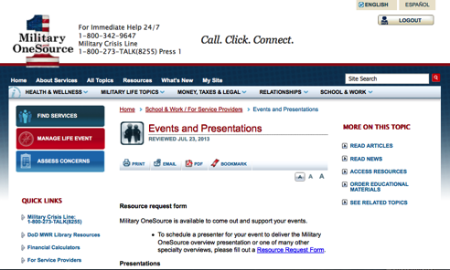

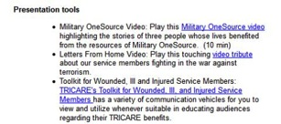
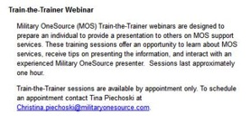
Events and Presentations
Notes:
Talking points
Presentations are available to educate others about Military OneSource.
To request a presenter to deliver the Military OneSource overview presentation or one of the specialty overviews during an event, fill out the Resource Request Form. You can find a full list of the specialty presentations on the service provider homepage.
Train the trainer sessions allow participants to learn more about Military OneSource services and to be coached on providing the Military OneSource overview. Trainees will become comfortable navigating the website, and can have questions answered by a Military OneSource representative. These sessions are offered weekly on Wednesdays at 2 p.m. EST, except on federal holidays. Schedule appointments from this page.
The sample Military OneSource consultant call allows you to share the experience of speaking with one of our consultants.
Briefer notes
If appropriate, mention the fact that a presentation on completing the on-demand event request form is available through the Joint Family Support Assistance Progam.

Slide 17

Military OneSource eNewsletter
Subscribe to
the newsletter
View current and
archived issues

Slide 18
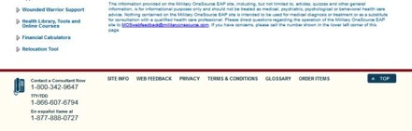
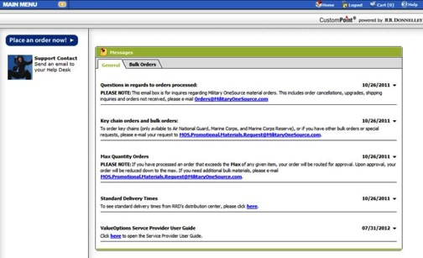
Orderable Materials
Order Military
OneSource
promotional materials
Notes:
Talking points
When you are logged into the Military OneSource employee assistance program website as a service provider, you will see a link at the bottom of the page that is labeled Order Materials. If you select that link, you will be routed to the portal for ordering promotional materials. Please note that members may order educational items throughout the site. This is a different feature.
Promotional materials consist of items like magnets, wallet cards and brochures used to promote the Military OneSource program. The maximum amount for each is generally sufficient for most service providers. Any orders exceeding the maximum quantity listed will be routed for approval.
Educational materials consist of CDs, booklets and other materials that provide in-depth content on specific topics. The distribution method of these resources is through an online or phone request by the service members or their families. Bulk orders of educational materials are not supported for the following reasons:
Participants are encouraged to call a consultant or visit www.MilitaryOneSource.mil to benefit from the full extent of Military OneSource services. By talking with a consultant, other needs may surface and additional resources may be recommended.
To prevent depletion of inventory for the end-user.
Military OneSource frequently updates educational material. It is preferable to order as needed to guarantee the most recent resources for the end-user.
Briefer notes
The new recruit card can be ordered by service providers only if they are working directly with new service members from all branches of the service.

Slide 19
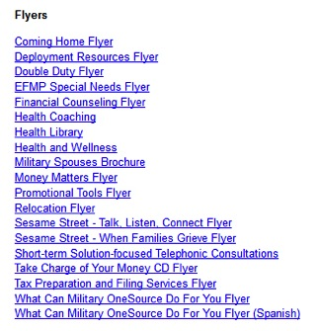


Printable Materials
Flyers
Topical lists
Program overview
Notes:
Talking points
Printable flyers, topical lists and a program overview are great when you need information fast to share with service members and their families or when supply is low. These materials also work great for promotional displays, briefings or classes.
The financial counseling flyer and the money matters topical list are resources to share in a budgeting class.
The health and wellness coaching flyer is a resource to share during a stress management class.
The Wounded, Ill and Injured toolkit has a variety of information to view and utilize whenever suitable in educating audiences regarding their TRICARE benefits.
Briefer notes
Use examples that apply for the service provider.

Slide 20
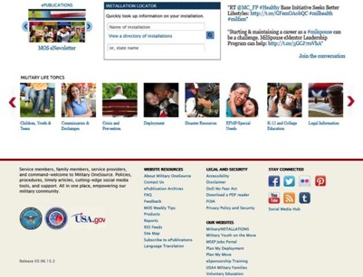
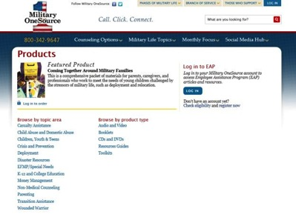
Finding Information and Products
Click to quickly access information available through Military OneSource.
Notes:
Talking points
Military OneSource has a products page with headers and sub-headers for specific topics to make it easy to quickly access information and educational materials available through the website.
Topics are categorized by subject and contain links to additional content areas containing informational subcategories listing articles, booklets, CDs and DVDs, online library resources, resource guides and useful web links.
Service members and family members can request educational materials online or by phone. Information is accessible via the products link at the bottom of the Military OneSource home page.
Service providers can order promotional materials to help promote Military OneSource resources and services by logging in to the employee assistance program area of the site.
Briefer notes
Familiarize yourself with multiple topics for varied audiences.

Slide 21
Affiliate Provider Information
Affiliate provider network criteria
  Master’s degree or higher
  Five years post-master’s clinical experience
  Minimum three years employee assistance program experience
More information on additional criteria and joining the network can be found at http://www.valueoptions.com/providers
Notes:
Talking points
Providers interested in joining the Military OneSource team can find affiliate provider network criteria, the link to join the network and access to the affiliate provider information from this page.
Briefer notes
Familiarize yourself with the affiliate provider network criteria. Some points of interest are listed below for quick reference. Refer the provider to the link on the affiliate provider homepage for a complete listing of the criteria.
Master’s degree or higher in counseling, social work, psychology or a related mental health profession
Minimum of five years post-graduate clinical experience
State license and certification in area(s) of specialty

Slide 22
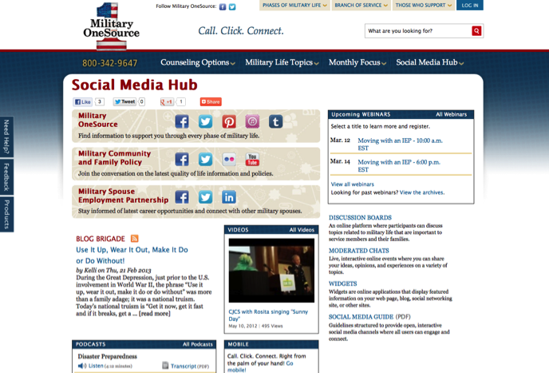
Social Media Hub
Notes:
Talking points
Access to Military OneSource social media outlets is conveniently located on the homepage.
View the Twitter feed on the right-hand side of the page.
Follow the link to the Military OneSource Facebook page.
The latest Blog Brigade entry can be found just below the image box, in the middle of the page.
More complete access to social media can be found by hovering over the Social Media Hub tab at the top of the homepage. Here you’ll find links to:
Social media hub
Blog Brigade
Discussion boards
Podcasts
Webinars
Widgets
Videos
Briefer notes
Explain some of the social media offerings and remind audience of upcoming webinars.

Slide 23
















Online Library Resources
Audio books, e-books, research, tutoring, exam prep, résumé builder and more!
Image of various online library resource logos
Notes:
Talking points
Military One Source provides electronic library resources at no cost 24 hours a day, 7 days a week and 365 days a year. Note for Guard, reserve and remote location audiences: This is a particularly helpful benefit for those who may not have physical access to an installation library.
The online resources are provided by the DoD Morale, Welfare and Recreation Library program and can be accessed through the Morale, Welfare and Recreation link under the Military Life Topics tab.
Briefer notes
Discuss some of the information that is available using the selected widgets on the slide. Not all resources available are represented on the slide.
Peterson’s Education Resource Center provides study guides and practice tests for SAT, ACT, CLEP, ASVAB, certifications and more, as well as help with scholarships and the admissions process.
Morningstar Investment Research Center offers information and advice on mutual funds, stocks, exchange traded funds and companies.
Career Transitions helps users find job announcements, write a resume, map military experience to civilian jobs, write a cover letter, access career interests and participate in an interview simulation.
Master File Premier and Academic One Source links to scholarly and informational full-text journal articles, including extensive coverage of the sciences, technology, medicine, the arts, theology, literature, history and culture.
Auto Repair Reference Center offers complete automotive repair manuals, 1954 to current.
Heritage Quest offers an essential collection of unique materials for both genealogical and historical researchers with coverage dating back to the late 1700s.
Kids InfoBits is designed especially for students in kindergarten through grade five.
Culture Grams allows users to experience the world and its people through detailed cultural information on more than 200 countries through both adult and child interfaces.
One Click Digital and EBSCO eBooks Collection offers downloadable audio files and eBooks for checkout.
TumbleBook Library is an online collection of eBooks for reading, listening and playing games for ages 4-12.
Safari Books Online is an eReference library with thousands of business and information technology books.
Tutor.com is a one-on-one online live homework help site. See registration site for eligibility.
NewsBank offers electronic editions of the Army, Air Force, Marine Corps, Navy, and Federal Times and other Defense and Government publications.
Military and Intelligence Database is a custom collection of more than 500 journals, articles, books, and magazines with military and government relevance.

Slide 24
Access
You can expect:
24/7/365 worldwide access
Master’s-level consultants to answer your questions
Objective, experienced and caring people
Up-to-date and useful information
No cost
A commitment to quality
Toll-Free telephone
800-342-9647
MilitaryOneSource.mil
m.MilitaryOneSource.mil
Email your questions
to a consultant
Interaction with trained
outreach professionals
Notes:
Talking points
Military OneSource is available 24/7/365, in other words, when you need us, we are there.
You can call our toll-free number to talk to a trained master’s-level consultant who can offer confidential support and up-to-date practical solutions or appropriate referrals.
Or, access our website and browse through everything the site has to offer, including webinars, newsletters and all of the other support discussed during this presentation.
Even on the go, Military OneSource is at your fingertips. The mobile site allows you to reach all of the resources of the traditional Military OneSource website no matter where you are.
Access to some information and services, including confidential non-medical counseling, requires you to log-in. To do so, you will need to create your own user name and password.
You also have the option to email a consultant your question. The consultant will research your request and get back to you. If your request is urgent or time sensitive, you will want to call the toll-free number to speak with a live consultant.
All Military OneSource services and materials are available at no cost to service members and their families.
Additionally, Military OneSource is constantly looking for ways to improve the service, and values all feedback. We conduct surveys asking for information on your experience. The 12-question survey will periodically appear on the website, or you can access it direct via the Contact Us link.
For a situation where the service did not meet the expectation, there is a customer recovery process in place. Each complaint is documented and taken very seriously. All departments are notified to ensure proper training and actions are taken to immediately respond to the breakdown. Rest assured that Military OneSource truly cares for, and is committed to service members and families and strives for 100 percent customer satisfaction.

Slide 25
Questions?
Notes:
Talking points
Does anyone have any questions?
Let them know how long you will be around after the presentation, and where they can find you if they think of a question they would like to ask later on.
Direct additional questions to the Military OneSource call center at 800-342-9647.

Slide 26

Call. Click. Connect.
800-342-9647 MilitaryOneSource.mil
Notes:
Briefer notes
Point out the contact phone number and website to audience members and remind them to direct additional questions and concerns to a Military OneSource consultant through the call center.

