Slide 1
Service Providers
Notes:
Talking Points — Updated March 2016
Military OneSource logo. Call. 800-342-9647, Click. www.militaryonesource.mil, Connect. 24/7
Military OneSource is a Department of Defense-funded program that’s both a call center and a website, providing comprehensive information on every aspect of military life for free to active duty, National Guard and Reserve Component service members (regardless of activation status), their families and survivors. Information includes, but is not limited to, deployment, reunion and reintegration, relationship, grief, spouse employment and education, parenting, child care and much more.
Military OneSource has policy and programmatic information, helpful resources, products, articles and tips on numerous topics related to military life. Services are available 24 hours a day by telephone and online. In addition to the website support, Military OneSource offers call center and online support for consultations on a number of issues such as spouse education and career opportunities, issues specific to families with a member with special needs, health coaching, financial support and resources.

Slide 2
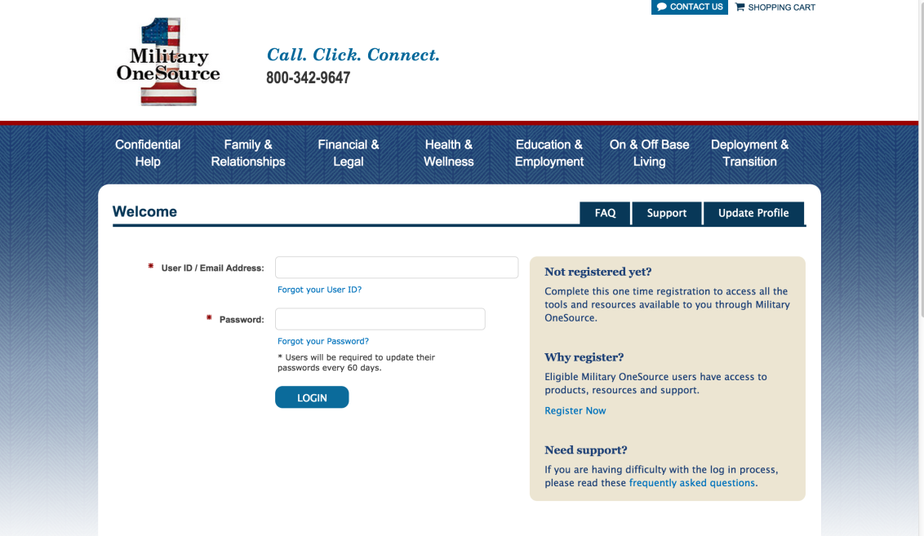
Login
Notes:
Talking Points — Updated March 2016
At the top of the Military OneSource home page (or any page on the website) click on the Login button at the top right-hand corner.
You’ll arrive at the screen where you log in with existing credentials or select Register Now if you haven’t already registered. If you have a username and password, select option to update your profile. When registering or updating your profile, be sure to select Service Provider as your role.
To register:
Identify the branch of service and component you support.
Identify the component that you support, your role (service provider) and the location you serve.
Create a username and password and enter your email address.
Check the box stating you are eligible to access Military OneSource. All service providers are eligible to access Military OneSource.
Briefer notes
If the service provider supports more than one branch or component, have them select the primary one that they support.

Slide 3
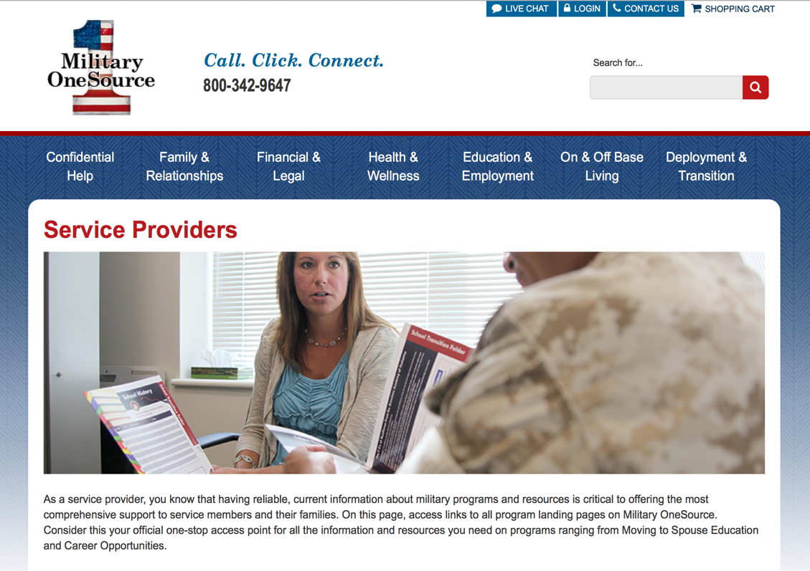
Service provider home page
Notes:
Talking Points — Updated March 2016
Once you’ve logged in, there are a few places you can search for specific service provider resources and information.
In the Military OneSource website you can access resources for service providers by going to the Military OneSource home page and scrolling down to the “Looking for this?” section.
Move through that carousel until you find Service Providers and click on it.
This will take you to the Service Provider’s main page.
You don’t have to be logged in to access the information on the Service Providers page, but you do have to be logged in to place orders for the no-cost products.

Slide 4
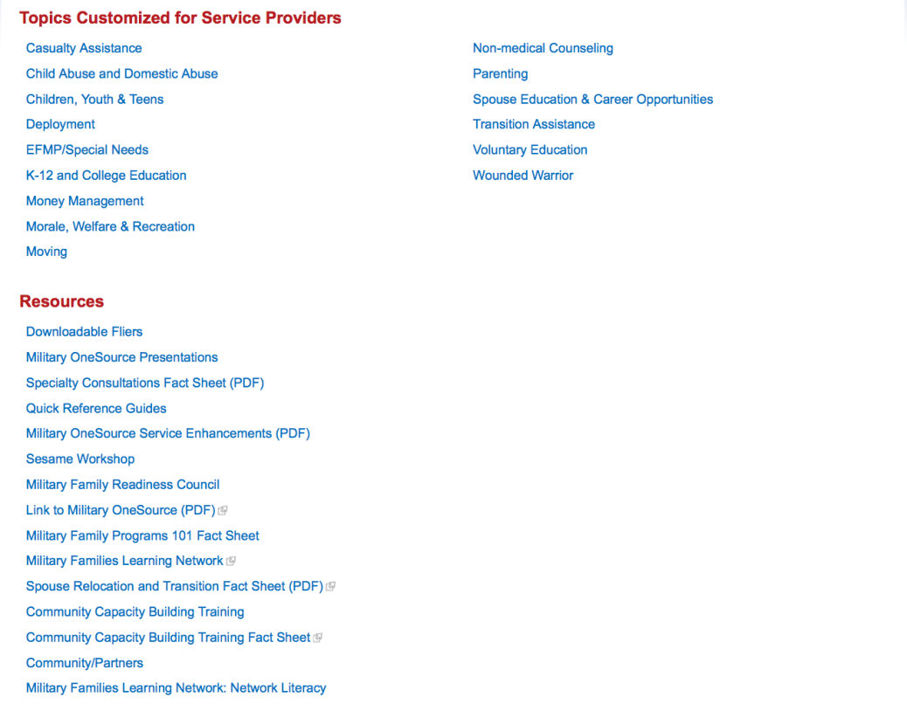
Service provider resources
Notes:
Talking Points — Updated March 2016
Now that we know where to find the resources, let’s talk about what those resources are.
On Military OneSource you will find the following:
Information by topic (by program names) and you can find valuable resources (by resource type), including quick reference guides and downloadable fliers.
Topics Customized for Service Providers (by program names)
Casualty Assistance
Child Abuse and Domestic Abuse
Children, Youth & Teens
Deployment
EFMP/Special Needs
K-12 and College Education
Money Management
Morale, Welfare & Recreation
Moving
Non-medical Counseling
Parenting
Spouse Education & Career Opportunities
Transition Assistance
Voluntary Education
Wounded Warrior
Resources (by resource type)
Downloadable Fliers
Military OneSource Presentations
Specialty Consultations Fact Sheet (PDF)
Quick Reference Guides
Military OneSource Service Enhancements (PDF)
Sesame Workshop
Military Family Readiness Council
Link to Military OneSource (PDF)
Military Family Programs 101 Fact Sheet
Military Families Learning Network
Spouse Relocation and Transition Fact Sheet (PDF)
Community Capacity Building Training
Community Capacity Building Training Fact Sheet
Community/Partners
Military Families Learning Network: Network Literacy
At the bottom of the website, in the footer, you will find more resources under the following headers including:
Military OneSource: This header includes information such as the About Us page, contact information, emergency contact, frequently asked questions, the MC&FP Websites and Applications, reports and surveys and a site map
Categories: Below this header you will find links to each category page on the website
eNewsletter: Under this header we’ve stored information including subscription options for all of the eNewsletters that can keep you informed of the most current or recently updated resources as well as the archives page
Legal and Security: Information listed under this header includes Accessibility, Accessibility Tools, Disclaimer, DoD No Fear Act, FOIA and Privacy Act Statement and Security

Slide 5
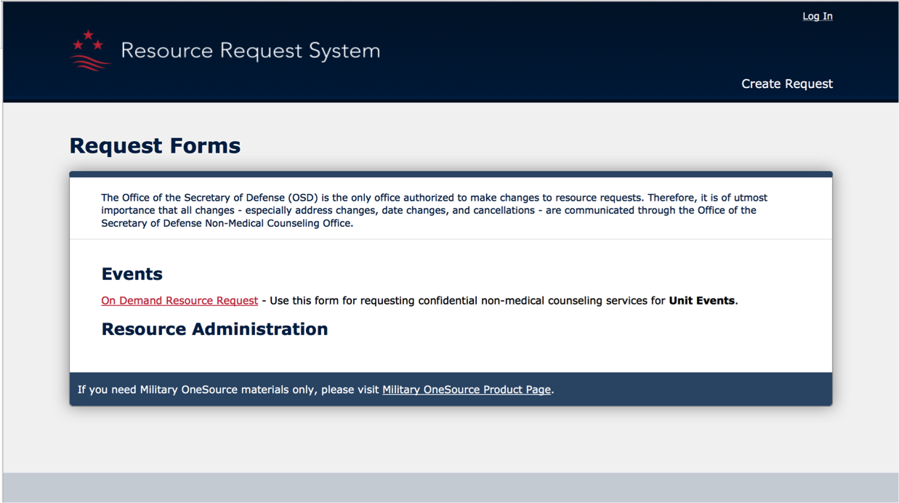
Events and presentations
Notes:
Talking Points — Updated March 2016
Presentations are available to educate others about Military OneSource.
You can see a list of available presentations by going to the Service Providers home page and under the Resources header, click on Military OneSource Presentations.
To request a presenter to deliver the Military OneSource overview presentation or one of the specialty overviews during an event, fill out the Resource Request Form.
You can find the Resource Request Form by scrolling to the Military OneSource footer and clicking on MC&FP Websites and Applications and then clicking on the Resource Request System in that list.
The Resource Request System allows military units and military-connected organizations to request in-person services through the Military OneSource and Military and Family Life Counseling Programs. Eligible service members and their families may receive support from Military OneSource representatives, military and family life counselors, child and youth behavioral counselors, and personal financial counselors on short-term assignments.

Slide 6
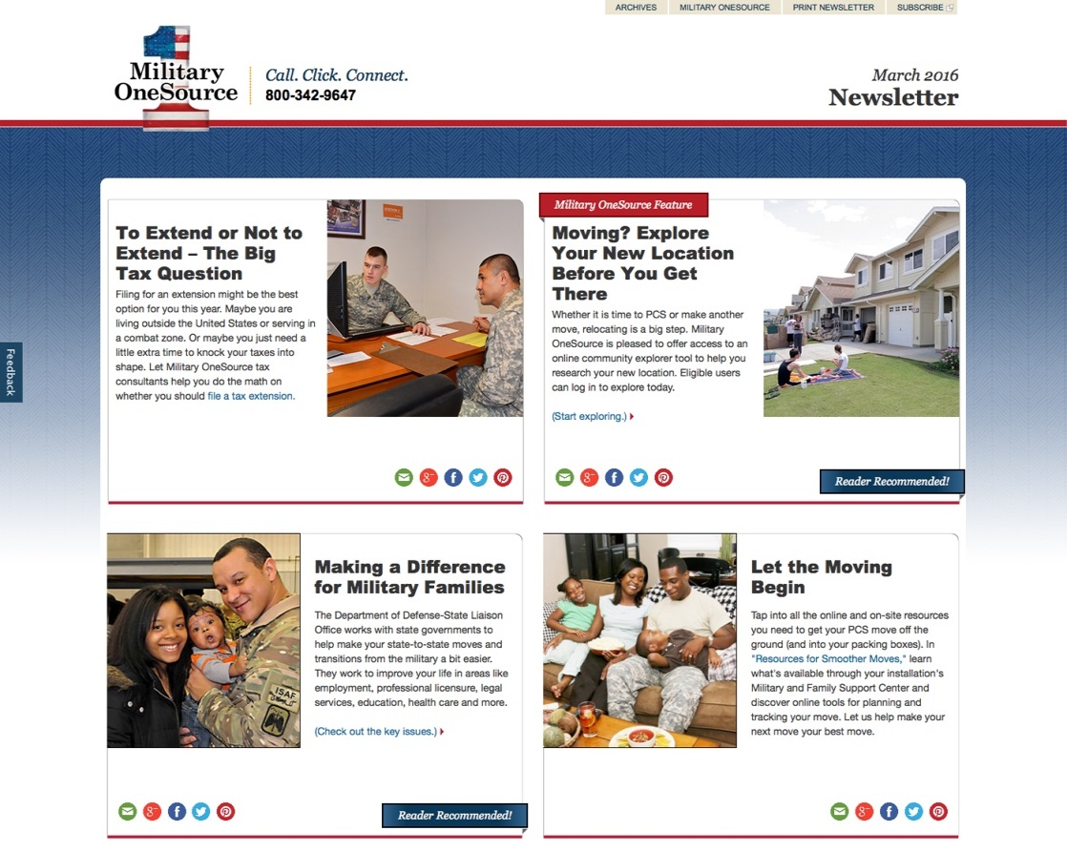
Military OneSource eNewsletter
Subscribe to the eNewsletter
View current and archived issues
Notes:
Talking Points — Updated March 2016
Sign up for the Military OneSource eNewsletter today. The eNewsletter ensures you’re the first to know about resources as they become available — including information that matters to both service members and military families.
You can locate this and subscribe to receive it through the link found in the footer at the bottom of any page on Military OneSource.

Slide 7
Printable materials
Fliers
Topical lists
Program overview
Notes:
Talking Points — Updated March 2016
Printable fliers, topical lists and a program overview are great when you need information fast to share with service members and their families or when supply is low. These materials also work great for promotional displays, briefings or classes.
The financial counseling flier and the money matters topical list are resources to share in a budgeting class.
The health and wellness coaching flier is a resource to share during a stress management class.
The Wounded, Ill and Injured tool kit has a variety of information to view and utilize whenever suitable in educating audiences regarding their TRICARE benefits.
Briefer notes
Use examples that apply for the service provider.

Slide 8
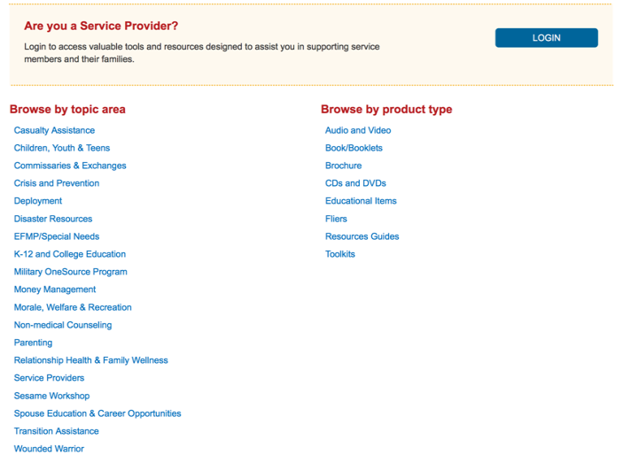
Finding information and products
Click to quickly access information available through Military OneSource
Notes:
Talking Points — Updated March 2016
Click on the Products link (shopping cart icon found in the “Looking for this?” carousel at the bottom of the Military OneSource page)
Military OneSource has a products page with headings and subheadings for specific topics to make it easy to quickly access information and educational materials available through the website.
Topics are categorized by subject and contain links to additional content areas containing informational subcategories listing articles, booklets, CDs and DVDs, online library resources, resource guides and useful Web links.
Service members and family members can request educational materials online or by phone. Information is accessible via the products link at the bottom of the Military OneSource home page.
Service providers can order promotional materials to help promote Military OneSource resources and services by logging in.
Briefer notes
Familiarize yourself with multiple topics for varied audiences.

Slide 9
Affiliate provider information
Affiliate provider network criteria:
Master’s degree or higher in counseling, social work, psychology or related mental health profession
Five years post-master’s clinical experience
Minimum three years employee assistance program experience
State license and certification in areas of specialty
For more information on joining the network or for additional criteria, visit http://www.valueoptions.com/providers
Notes:
Talking Points — Updated March 2016
Providers interested in joining the Military OneSource team can find affiliate provider network criteria, the link to join the network and access to the affiliate provider information from this page.
Briefer notes
Familiarize yourself with the affiliate provider network criteria. Refer the provider to the link on the affiliate provider home page for a complete listing of the criteria.

