Slide 1

Pre-Deployment
Notes:
Military OneSource logo. Call. 800-342-9647, Click. www.militaryonesource.mil, Connect. 24/7
Military OneSource is a Department of Defense-funded program providing comprehensive information on every aspect of military life at no cost to active duty, National Guard and Reserve Component service members, and their families. Information includes but is not limited to deployment, reunion and reintegration, relationship, grief, spouse employment and education, parenting and child care, and much more.
Military OneSource has policy and programmatic information, helpful resources, products, articles and tips on numerous topics related to military life. Services are available 24 hours a day by telephone and online. In addition to the website support, Military OneSource offers call center and online support for consultations on a number of issues such as spouse education and career opportunities, issues specific to families with a member with special needs, health coaching, financial support and resources.

Slide 2
General Eligibility
Active duty, National Guard and Reserve Component service members
Immediate family members
Coast Guard when activated with the Navy
Civilian Expeditionary Workforce
Notes:
Talking points
All active duty, National Guard and Reserve Component service members and their immediate family members, including spouses, children or anyone legally responsible for a service member’s children during a time of separation or deployment are eligible, regardless of activation.
Members of the Coast Guard are eligible when activated and deployed with the Navy.
Civilian Expeditionary Workforce members and their families are eligible while deployed and 90 days prior and 180 days post deployment.
Briefer notes
Individual Ready Reserve personnel are eligible.
Eligibility begins on the initial entrance date (that is, official entrance date into the military or date of delayed enlistment).
A person transitioning out of the military by way of honorable discharge or retirement is eligible up to 180 days.
In general, extended family is not eligible.
Ineligible Coast Guard members don’t qualify because they are under the Department of Homeland Security, not DoD.
Extended program eligibility reaches anyone who is Defense Enrollment Eligibility Reporting System – more commonly known as DEERS – eligible, including survivors (non-remarried spouses and children) of active duty, National Guard and Reserve Component service members regardless of activation status and lifetime eligibility through the Wounded Warrior Resources.

Slide 3
Private and Confidential
Privacy is protected
Your personal information will not be
  Provided to the military or chain of command
  Shared with family or friends
  Released to other agencies
Privacy Exceptions
Duty to warn
Suspected family maltreatment (domestic violence, child or elder abuse or neglect)
Harm to self or others
Illegal activity
Notes:
Talking points
Contacts with Military OneSource, whether by telephone, online or face-to-face non-medical counseling, are private.
Military OneSource ensures that personal information is secure and each user is treated confidentially and with respect, regardless of rank.
Neither service members nor their commanders are advised when a family member seeks Military OneSource non-medical counseling.
Privacy exceptions include suspected family maltreatment (for example, domestic violence, child or elder abuse or neglect), threats to harm self or others and illegal activities. In these cases, Military OneSource consultants have a duty to report to the appropriate military and civilian authorities. Face-to-face counselors are an extension of Military OneSource, so these reporting requirements apply to them as well.
Briefer notes
Substance or alcohol abuse is disclosed only when:
The service member self-reports drug abuse violating DoD regulations
The family member reports alcohol abuse related to domestic violence perpetrated by the service member or abuse or neglect of a child or special needs family member
Illegal activity has occurred (anything that breaks local, state or federal law will be reported under duty to warn, including illegal drug use, operating a vehicle under the influence, underage drinking, etc.)
Air Force personnel are read the following additional statement regarding the Personnel Reliability Program self-reporting requirement: “As a Personnel Reliability Program certified or administrative qualified member, you are responsible to self-notify your Certifying Official of any behavior or circumstances that may or could reduce effectiveness or capability in your job performance, safety or personal reliability. This includes your physical and mental wellness, dependability, or financial or legal concerns. You are also required to self-notify prior to any health care evaluation or treatment, whether military or private that you are a PRP individual. Failure to make notification may cast doubt on your reliability and violates DoD and United States Air Force policy in DoD Regulation 5210.42.”

Slide 4

Range of Support
Community Resources & Referrals
Financial
Deployment
Health Coaching
Life Transitions
Relationships
Moving
Children & Youth
Libraries
Special Needs
Career & Education
Confidential Non-medical Counseling
Notes:
Talking points
Military OneSource offers support on a wide variety of topics. Many are interconnected, depending on the situation. For example, a family may call about relocation issues. Discussion of those issues may lead to assistance with new jobs, education counseling if the spouse is in the middle of school, etc.
Briefer notes
Presenter can share relevant examples about the many uses of Military OneSource.

Slide 5





Military OneSource:
Something for Everyone
Did you know Military OneSource has…
  Smart shopping tips (audio clips)
  Planning for your golden years (video)
  Connecting with your child (booklet)
  Dealing with your stress (downloadable)
  Disaster preparation (webinar)
Notes:
Talking points
Military OneSource has resources for everyone, no matter how long they have been affiliated with the military, and the resources are not just related to military life, but life in general.
Some of the resources that people tend not to know about are:
ePublications
Pet sitting information
Healthy meal planning tips
Links to outside agencies that provide emergency services
Locators to find schools and other resources
Explore Military OneSource to find out what else we have available.

Slide 6


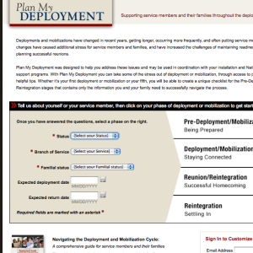
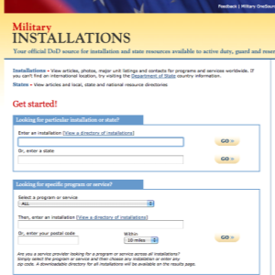
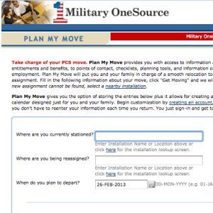

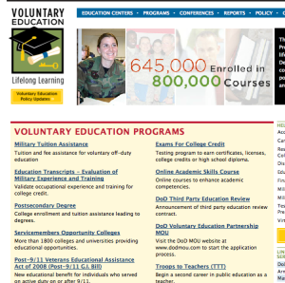
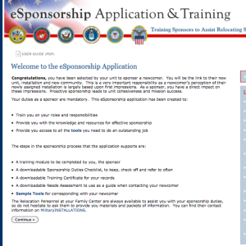
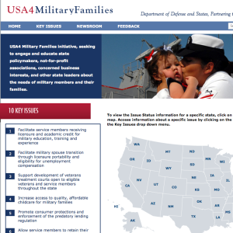
Our Websites
Notes:
Talking points
At the bottom of any Military OneSource page you will find links to Our Websites. These websites will further assist service members and family members with several things, including deployment, moving, locating installation services and much more!
Our websites include:
MilitaryINSTALLATIONS - MilitaryINSTALLATIONS allows you to search for programs and services on your installation.
Military Youth on the Move - This website is divided into kid, pre-teen, teenager and parent sections. You’ll find age appropriate information for your child to ease common struggles, including healthy living, safety, moving and new schools, money, and making new friends.
Military Spouse Employment Partnership Jobs Portal - The MSEP job portal is a job search engine specifically for military spouses. By entering the city, state and country of residence, spouses can browse through available jobs in the area. An advanced search allows spouses to search for a specific line of work.
Plan My Deployment - This tool helps service members and families understand what to expect and when throughout the deployment cycle. Entering the service member’s status, service branch, familial status, and expected deployment and return dates results in a personalized plan to help service members and families prepare for deployment.
Plan My Move - Similar to the personalized plans of Plan My Deployment, Plan My Move helps military service members and families create a timeline for a smooth move. Plug in your current duty station, new duty station and your departure date for your personalized timeline.
eSponsorship Training - If you have been assigned sponsorship of a newcomer, use your Common Access Card – known as the CAC – to access the eSponsorship application and training. You can also use this resource to communicate electronically and manage the sponsorship online.
MySECO - The MySECO website ensures spouses have 24/7 access to online education and career information, resources, tools and assessments. Using the tools and assessments, spouses can begin to explore their interests, skills, passions and personality type to determine the best fit for education and career choices and start to build a portable and meaningful career path.
USA4 Military Families - This website supports military families by explaining key issues that directly impact military service members and families. See the latest news or explore the key issues.
Voluntary Education - The Voluntary Education Portal offers guidance for anyone in the DoD community continuing their education. Information can be found about tuition assistance, the Post 9/11 G.I. Bill, Troops to Teachers, the Online Academic Skills Course, exams for college credit and much more.

Slide 7
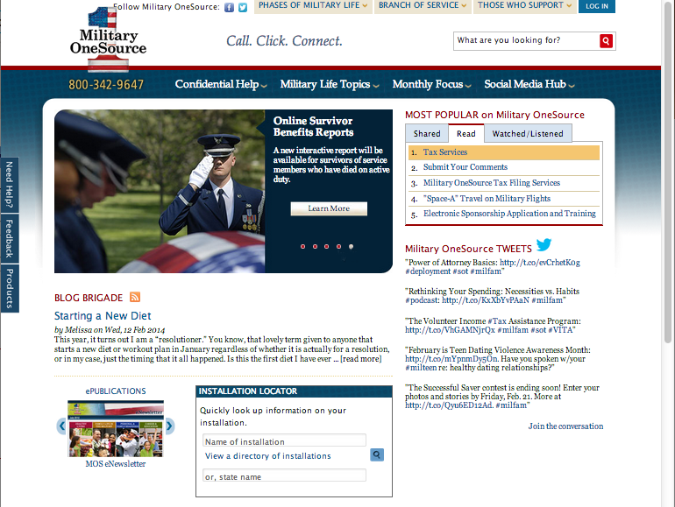
Military OneSource Homepage
Notes:
Talking points
There are two points of entry to the Military OneSource website the public and employee assistance program side. The public side offers a number of articles on military life topics and much more for service member, families, service providers, and leaders and requires no log in. If you are an eligible service or family member and would like to have access to confidential non-medical counseling, products and specialty consultations, select the log- in button at the top of this page. Note, that once you log into the employee assistance program side, you have left the public side of Military OneSource website.
The homepage offers quick access to:
Links to program pages
The most popular site content
An installation directory to help you find the resources closest to you
All of the available counseling options
Under the Military Life Topics tab, you will find links to each program page. Clicking on any link will take you to that program’s homepage where you will find a wealth of articles, resources and external links.
If you’re interested in the latest hot topics, browse the MOST POPULAR on Military OneSource menu in the top right-hand corner of the homepage. When something peaks your interest, simply click the link to read, watch or hear more.
The Installation Locator box in the middle of the page is your quick reference to all things about your current or soon-to-be installation. Simply fill in your installation’s name, state name or select your installation from the directory. This feature will also provide information on local support providers, like the Red Cross and Joint Force headquarters.
Hovering over the Confidential Help tab will immediately reveal contact phone numbers for instant contact or options for face-to-face, telephonic and online confidential non-medical counseling as well as confidential specialty consultation options (for example, adoption, health and wellness coaching, special needs and wounded warrior) and other services.

Slide 8
Military OneSource Homepage
Notes:
Talking points
Left menu:
The Need Help? tab takes users to options for confidential non-medical counseling services.
The Feedback tab navigates to a contact form for comments and suggestions, technical support or website accessibility.
The Products tab takes users to a menu of available products arranged by topic or product type, including audio and video tips, booklets, CDs and DVDs, resource guides and toolkits.
Top menu:
Hover over the Phases of Military Life tab to find helpful information no matter your current phase of military life, including new to the military, single life, career, Guard and reserve, deployment, family life, military leadership and retiring.
Click your branch of service under the Branch of Service tab for information specific to the Army, Marine Corps, Navy or Air Force.
The Those who Support tab leads to information specifically for community partners, leaders or command, and service providers.
The Log In tab takes users to a page that requires a username and password. While much of the information on Military OneSource is public, certain services, including confidential non-medical counseling, products and confidential specialty consultations are available only to eligible individuals through a secure log in.
Briefer notes
Note that the links for the ePublication Archives and MilitaryINSTALLATIONS, along with many more links, can be found at the bottom of the page.

Slide 9
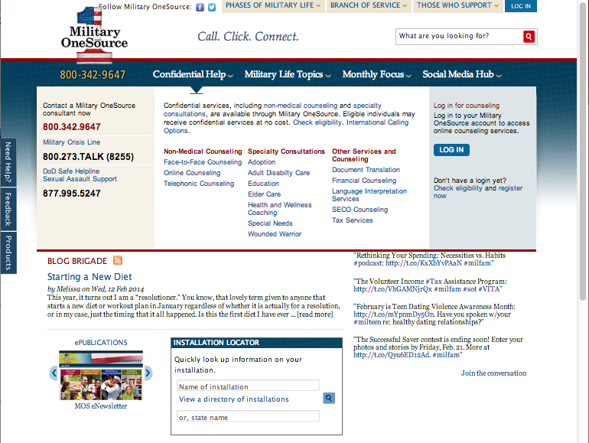
Confidential Help
Notes:
Talking points
Service members and family members can find confidential non-medical counseling information through the toll-free number, 800-342-9647 or through the links on any Military OneSource page by:
Hovering over the Confidential Help tab in the menu at the top of any page to see phone numbers for immediate support and the available counseling options offered through Military OneSource and a description of each, confidential non-medical counseling and specialty consultations as well as other services and counseling options.
Clicking the Military Life Topics tab in the menu at the top of any page to reveal a list of program pages. Selecting the non-medical counseling link will navigate to the program page for more information about Military OneSource confidential non-medical counseling options.
Clicking the Need Help? button in the left-hand margin of any Military OneSource page to be immediately taken to a simplified Counseling Services page.
Military OneSource confidential non-medical counseling:
Provides up to 12 confidential non-medical counseling sessions, per person, per issue at no cost. Note: financial counseling is unlimited.
Provides confidential short-term counseling to eligible individuals with such issues as: relocation, separation, reintegration, relationship issues, parenting skills, communication, anger management, grief, stress, deployment, life skills, coping skills, interpersonal skills and academic or occupational problems.
Is available via three different methods for convenience and generational preferences: face-to-face, telephonic and online. The Military OneSource consultant will assess your situation and help determine the most beneficial method. In most cases, referrals are made within 72 hours.
Does not provide or determine medical diagnosis. It is not a part of TRICARE, nor does it substitute for authorizations required for reimbursement under TRICARE.
Is not intended to be a part of a patient’s Medical Treatment Facility discharge plan or treatment of suicidal or homicidal thoughts, or Family Advocacy Program cases. It is not intended to address sexual assault, abuse, mental health conditions requiring in-patient hospitalizations and other behavioral concerns.
Military OneSource confidential specialty consultations:
Are available online or over the phone with specialists in various fields, including adoption, health and wellness coaching, special needs and wounded warrior.
Can be scheduled by calling Military OneSource at 800-342-9647 and asking for an appointment in one of the specialized areas.
Other Military OneSource services and counseling include:
Document translation
Financial counseling with certified financial planners
SECO counseling to help military spouses with career exploration, education, training and licensure, employment readiness, and career connections
Tax services
Briefer notes
Children are eligible for Military OneSource confidential non-medical face-to-face or telephonic counseling if:
A parent attends (for example, family counseling) with a child younger than 13
A parent brings a child between 13 and 18 to the individual counseling session
The child is 18 years or older

Slide 10
Plan My Deployment
Notes:
Talking points
First fill in the required fields, status, branch of service and familial status.
Then make your selection from the menu on the right. Choose from:
Pre-deployment/mobilization (being prepared)
Deployment/mobilization (staying connected)
Reunion/reintegration (successful homecoming)
Reintegration (settling in)
After you make your selection, you can view to-do lists and tips based on the criteria you entered (that is, your status, branch of service and familial status). You will also see a list of support resources for deployment that are specific to your service branch and a list of deployment tasks that will help you become more organized during this phase. You can customize your deployment list by selecting Customize Master Checklist. Once you make your selection of tasks you can click on the download button to create your unique master list.
Enter your deployment and return date for more specific information.
Briefer notes
Plan my Deployment can be found by selecting Deployment from the Military Life Topics tab at the top of the homepage.
The link for Plan my Deployment is listed under Popular Links.

Slide 11
Maintaining the Homefront
Remember everyone who is impacted, and identify potential needs and resources.
Spouses
Children
Extended family
Friends
Significant others
Notes:
Talking points
It is important to remember all of those that are affected by the deployment of your service member, and be sure that each one is aware of the information and resources that are available to assist during the deployment.

Slide 12
Service Members
Topics
Preparing yourself financially and legally
Equipping yourself physically
Taking care of your property and pets
Ensuring your family is covered
Resources
“The Service Members' Civil Relief Act”(article)
“Sleep in Combat Operations” (pocket kit)
“Double Duty” and “Over There” (CDs)
“Getting Your Vehicle Ready for Storage” (article)
“Preparing a Family Care Plan” (article)
Notes:
Talking points
As the service member, you have had plenty of training on preparing for your deployment, but there may be a few things that have not yet been addressed. One question to consider is whether you have completed all the necessary things related to your financial and legal rights, particularly under the Service Members’ Civil Relief Act. Military OneSource has an article dedicated to explaining the Service Members’ Civil Relief Act and the major points under the Act.
As you transition from living and sleeping in your comfortable and familiar home to doing those things in less familiar surroundings, remember that Military OneSource can help prepare you for that change. Military OneSource offers the booklet, “Sleep in Combat Operations,” which provides helpful tips on the effects of sleep during deployments in theater. It comes with a sleep mask.
Being both a parent and a deployed service member requires focus and commitment. Our “Double Duty” CD describes ways to stay close with your child from before you deploy to after you return.
Being deployed when the rest of your family is back home can be hard for any military parent, but mothers may find it especially challenging. In our CD, “Over There,” mothers who have already experienced a deployment discuss the unique challenges that mothers face when they’re over there.
It is also important that you take care of your property and pets prior to deployment. On Military OneSource you can find articles to help walk you through the process of considering what to do with your vehicle, home and pets.
Of course, the most important thing you are leaving behind is your family. Nearly everyone in the military can benefit from preparing a family care plan that shows how your family is to be cared for in your absence.

Slide 13
Spouses and Significant Others
Topics
Preparing yourself emotionally
Ensuring your home and life are ready
Getting your family unit equipped
Resources
“These Boots” (CD)
“Preparing for Deployment: The Home Side” (article)
“Managing the Emotional Cycle of Deployment when your Spouse is Deployed” (article)
Notes:
Talking points
The deployment of a family member can be a very emotional and difficult time for many families, but by preparing as well as you can, you may find that you are better able to cope. Families should prepare as soon as possible by talking to children and extended family members about what will happen during deployment, adjusting their routines, and reviewing financial and legal details.
When your spouse or partner deploys, the emotional and practical challenges can seem overwhelming.
On the “These Boots” CD, a military wife of 18 years offers strategies to help the spouse at home prepare for deployment, survive (and even thrive) while "married but single" and get ready for homecoming.
Separation from a spouse or partner is hard, whether it's for six weeks or six months. The absence of a family member may mean that you'll have to do things differently at home and in the rest of your life. If you take the time to prepare for these changes, you may find it easier to adjust. The article, “Preparing for Deployment,” covers these topics.
You are likely to experience different emotions in clearly defined stages, starting when you first learn about the deployment and continuing until well after your spouse has returned. The article, “Managing the Emotional Cycle of Deployment when your Spouse is Deployed,” will help you know what to expect, and can help you recognize signs that you may be having trouble coping during any stage of the cycle.
Briefer notes
You may be asked about eligibility for significant others such as fiancées. Remember that they will be impacted by the deployment and that service members can order materials that will be able to provide information for them.

Slide 14
Children
Topics
Preparing your children
Interacting and connecting with your children
Entertaining and educating your children
Reviewing child care options
Resources
“Sesame Street: Talk, Listen and Connect: Deployments, Homecomings, Changes” (DVD)
“Choosing a Caregiver for your Child while you’re Deployed” (article)
Sittercity ®
Notes:
Talking points
We’ve talked about what resources Military OneSource has to prepare adults for deployment, but Military OneSource can also help parents effectively prepare children for deployment. We can also provide parents with material and resources that promote interaction and connection, both with the parent who is deploying and the parent who is in charge of the home front.
The “Sesame Street: Talk, Listen and Connect” DVD is a bilingual multimedia outreach program designed to support military families with children between the ages of two and five by letting them relate to Elmo’s experience as his family member deploys, returns home and prepares to deploy again.
Whether you will be at home with the children, or you’re the deploying parent, child care could be a concern. Military OneSource offers many services, such as child care locators and articles on how to choose a caregiver while you deploy. We also offer access to SitterCity to help you find local babysitters and nannies with background checks, references, reviews and more.

Slide 15
Teens
Topics
Preparing your teens
Interacting and connecting with your teens
Entertaining and educating your teens
Resources
“Teenagers and Deployment” (article)
“Staying Involved in your Child's or Teenager's Life when you're Deployed”
“Helping Children Cope During Deployment” (article)
Tutor.com™
Notes:
Talking points
Deployment can be especially hard on teenagers, who are often experiencing turmoil of their own simply because of their age. But your support can go a long way toward helping your teenager deal with the difficulties of your deployment. In fact, as the “Teenagers and Deployment” article discusses, the deployment period can be a time of personal growth when your teenager takes on added responsibilities and makes emotional adjustments. Military OneSource offers this article and more to help your teen and the rest of your family get through deployment.
Tutor.com provides tutoring the way it was meant to be. You get an expert tutor for more than 16 subjects 24/7, and your child will work one-on-one with the tutor in an online classroom on your specific problem until it’s done. You never need to make an appointment – or even leave the house! You can get a tutor whenever you want, from anywhere in the world.

Slide 16


Extended Family and Friends
Military OneSource
MilitaryINSTALLATIONS
Caregiver resources
Notes:
Talking points
As a parent, extended family member or friend of a service member, you may have questions on how you can best support your service member.
You can access Military OneSource online for information and articles for many of the challenges you may be experiencing.
You can also access MilitaryINSTALLATIONS, which is a database of information, resources and contact phone numbers for all active duty military installations.
If you have elected to take care of your service member’s affairs while they are deployed or mobilized and questions arise, you can contact the call center and request assistance. This includes assistance and resources for the children of the service members.

Slide 17
Financial Services
Financial Counseling
Budgeting and general financial management
Debt management
Housing counseling
Financial Planning
Investing
Retirement planning
Planning for college
TSP/401K/Pensions
Traditional and
ROTH IRAs
Assistance in selecting a certified financial planner in the local community
Tax questions and preparation
Notes:
Talking points
In addition to a wide variety of financial resources available through Military OneSource, financial counseling is also available at no cost to the service member or family member. Please call the toll-free number to set up a phone consultation with one of our personal financial counselors. Face-to-face financial counseling may also be available. A Military OneSource consultant can let you know about availability in your area.
You can talk with a certified financial counselor about budgeting and debt management. You can even get information on housing issues, such as pre-purchase, foreclosure prevention and reverse mortgages. Or, if you prefer, you can speak with a certified financial planner about everything from saving and investing to retirement planning. When it comes to financial support, Military OneSource has something for everyone, no matter your financial situation.
Briefer notes
All Military OneSource financial counselors are accredited financial counselors.
Military OneSource financial counselors are available to provide education and not to advise on options.
Affiliates are prohibited from making referrals to themselves or to another network affiliate for fee-based work as a result of a consultation. Also, sales of products or services to participants served through the financial counseling program are prohibited.

Slide 18
Health and Wellness Coaching
Individual coaching sessions
  Telephone-based
  Online
Health and wellness issues
  Weight loss
  Fitness and exercise
  Nutrition
  General health (stress management, resiliency, etc.)
Health risk assessments
  Individualized plans
  Goal setting
  Outreach and engagement
Self-directed coaching
  LivingEasy ™
  LivingLean ™
  LivingFit ™
  LivingFree ™
Notes:
Talking points
If you are looking for expert advice on losing weight, making healthier food choices, learning which exercises best benefit your heart, handling stressful situation or how to relax, Military OneSource can help you reach your goals.
The Military OneSource Health and Wellness Coaching Program has experienced professionals who provide guidance, support and encouragement. You will be assigned a personal coach who you will communicate with by phone or online. Online self-directed programs are also available for people who are highly motivated and self-disciplined.
With online coaching, the Health and Wellness Coaches keep in touch through emails to provide support and observe progress. In addition to emails, online discussions with your coach are available. After posting a message, your coach will respond within one business day. Your coach will help you determine the right number of sessions.
The Health Risk Assessment is a tool used to assess the health risk of an individual. The assessment is essential in determining the coaching focus and designing an individualized plan that can assist in the achievement of goals as well as provide an idea of the outreach and engagement required from your coach.
The coaches can be accessed by calling Military OneSource or by requesting coaching through the Online Consultation request form.
Military OneSource also offers the Living series at no cost - online self-directed health and wellness coaching programs - to help you make lasting life changes. The Living series offers four online health and wellness courses:
LivingEasy: Resilience & Stress Management - This series of four online courses uses audio, visuals, animation, quizzes and a printable manual to help you build a strong foundation of resilience, courage and confidence.
LivingFit: 90-day Walking Program - With the help of this 12-week program, you will develop and enjoy the habit of exercise!
LivingLean: Weight Management Program - This eight-week course uses multimedia, an interactive workbook and emails to help you live healthy, lean and free.
LivingFree: Smoking Cessation Program - This four-week training can work for you by treating the root emotional and physical causes of smoking.

Slide 19
Career
Topics
Choosing a career
Finding a job
Effectiveness at work
Management skills
Resources
Spouse Education & Career Opportunities Center
  Career assessments
  Employment readiness
    Web links
    Newsletters
Military Spouse Employment Partnership
Notes:
Talking points
We understand the challenges of mobile military life and offer employment resources all across the spectrum, including deciding on a career, looking for employment, transitioning to new employment, dealing with career issues or looking to enrich management skills.
Military OneSource consultants are available to assist with questions on training, education or other career-related matters.
Briefer notes
Eligibility for services may differ for service members and spouses, but everyone can benefit from all of the educational materials, articles, CDs and booklets available through Military OneSource.

Slide 20
Education
Topics
K-12 education
Adjusting to college
Financial aid and scholarships
Alternatives to college
Continuing education
Resources
School locators
DoD Morale, Welfare and Recreation Libraries Education Resource Center
College Navigator
Military Spouse Education Resource Guide
Military Spouse Employment Partnership
Spouse Education & Career Opportunities Center
Notes:
Talking points
Education is a very broad topic that begins in pre-school and continues as lifelong learning.
When it comes to early childhood education, you may have questions about how to choose a school, how to help your child with homework or what resources are available for home school.
Military OneSource has services like school locators and the DoD Morale, Welfare and Recreation online library resources, which provides a wealth of information, access to TumbleReadables for book reports and programs like InfoTrac Junior for research papers.
No matter when you decide to think about college, for your child or for yourself, it can be an exciting adventure and one that can often lead to anxiety. You may have questions like:
“How am I going to pay for it?”
“Is this the right time to go back to school?”
“Can I handle college life?”
“Which school should I go to?”
Note: Refer family members to the website for the latest information and Frequently Asked Questions.
There are also services that you can access online, like the College Navigator (http://www.militaryonesource.mil/voluntary-education-service-members), which can help you look at school size, curricula, costs and location to help you determine which school might be best for you.

Slide 21
Spouse Education and
Career Opportunities Program
Military Spouse Career Center at Military OneSource
Spouse Education and Career Opportunities comprehensive counseling service available to ALL military spouses.
Career exploration and discovery
Education, training and state licensing/credentialing requirements
Employment readiness
Career connections
https://www.militaryonesource.mil/ and https://myseco.militaryonesource.mil
My Career Advancement Accounts Scholarship Program
Financial assistance for spouses of Service members in pay-grades of E1-E5, O1-O2 and W1-W2
Up to $4,000 for education/training and license/credential in a portable career
Financial assistance provided to more than 43,000 spouses in fiscal year 2012
https://aiportal.acc.af.mil/mycaa/
Military Spouse Employment Partnership
Web-enabled employment and career partnership connect military spouses with vetted Fortune 500 PLUS employers – 231 corporate partners
Partners’ Statements of Support to increase employment, provide career promotion opportunities and ensure pay equity for military spouses
Spouse Ambassador Network
https://msepjobs.militaryonesource.mil/

Slide 22
YMCA Services
Eligibility
Families of deployed Guard and reserve (Title 10 only)
Deployed at least six months
  Memberships renewed in six month increments
  Up to 18 months as long as usage requirements met
Respite child care
Up to 16 hours per month, per child
  Age 12 and under
  Age limits and availability differ at participating YMCA’s
Links
  www.militaryonesource.mil
  www.ASYMCA.org
Notes:
*Optional slide*
Appropriate to use at Guard and reserve pre-deployment events only. Exception: Not for use at Air Guard events or mixed events where Air Guard or active duty personnel may be present.
Talking points
The DoD sponsors YMCA memberships at no cost to support the needs of families of deployed Guard and reserve personnel who, for the most part, do not have access to family services and support programs available at military installations.
Eligibility requirements:
Title 10 personnel only, Title 32 not eligible because DoD is only funded for Title 10
The service member must be deployed for a minimum of six months
Deploying spouse eligible three months pre and post deployment
Military members and families are required to use the YMCA at least eight separate calendar days per month in order to qualify for membership renewal (Multiple family members attending on the same day only counts as one visit)
Memberships can be renewed in six month increments for up to 18 months if usage requirements are met
There are not provisions for reimbursements if the service member is already a member of the YMCA
Respite child care services:
Available to assist parents or guardians caring for the children (up to 12 years old) of a deployed service member
The service provides for up to 16 hours, per child, per month
It’s important to know that it is up to each YMCA as to whether or not, and to what age level, they participate in respite child care. Because of this, it’s important to review the information that is available on Military OneSource regarding the YMCA nearest you.
Access the links on the website for eligibility requirements, forms and more information.
Briefer notes
Do not brief on eligibility for active duty independent duty personnel and their families or eligibility for relocated spouses and family members of deployed active duty personnel. Refer individuals to the websites for information related to these areas if questions arise.

Slide 23
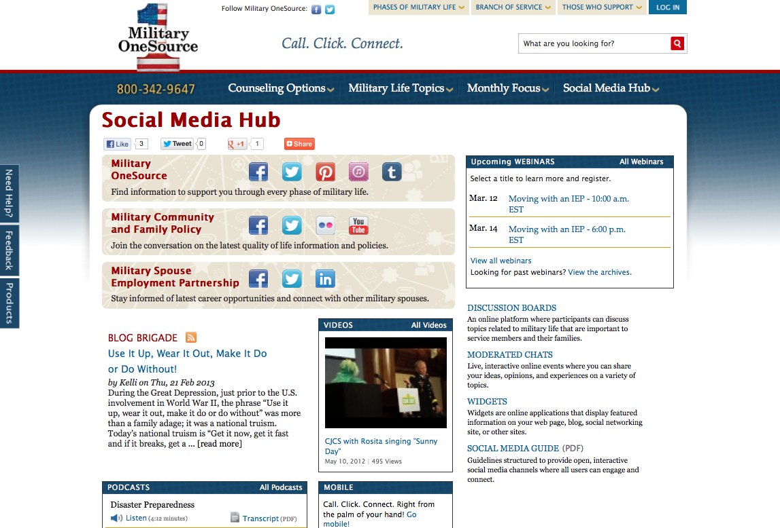
Social Media Hub
Notes:
Talking points
Access to Military OneSource social media outlets is conveniently located on the homepage.
View the Twitter feed on the right-hand side of the page.
Follow the link to the Military OneSource Facebook page.
The latest Blog Brigade entry can be found just below the image box, in the middle of the page.
More complete access to social media can be found by hovering over the Social Media Hub tab at the top of the homepage. Here you’ll find links to:
Social media hub
Blog Brigade
Discussion boards
Podcasts
Webinars
Widgets
Videos
Briefer notes
Explain some of the social media offerings and remind audience of upcoming webinars.

Slide 24
















Online Library Resources
Audio books, e-books, research, tutoring, exam prep, résumé builder and more!
Image of various online library resource logos
Notes:
Talking points
Military One Source provides electronic library resources at no cost 24 hours a day, 7 days a week and 365 days a year. Note for Guard, reserve and remote location audiences: This is a particularly helpful benefit for those who may not have physical access to an installation library.
The online resources are provided by the DoD Morale, Welfare and Recreation Library program and can be accessed through the Morale, Welfare and Recreation link under the Military Life Topics tab.
Briefer notes
Discuss some of the information that is available using the selected widgets on the slide. Not all resources available are represented on the slide.
Peterson’s Education Resource Center provides study guides and practice tests for SAT, ACT, CLEP, ASVAB, certifications and more, as well as help with scholarships and the admissions process.
Morningstar Investment Research Center offers information and advice on mutual funds, stocks, exchange traded funds and companies.
Career Transitions helps users find job announcements, write a resume, map military experience to civilian jobs, write a cover letter, access career interests and participate in an interview simulation.
Master File Premier and Academic One Source links to scholarly and informational full-text journal articles, including extensive coverage of the sciences, technology, medicine, the arts, theology, literature, history and culture.
Auto Repair Reference Center offers complete automotive repair manuals, 1954 to current.
Heritage Quest offers an essential collection of unique materials for both genealogical and historical researchers with coverage dating back to the late 1700s.
Kids InfoBits is designed especially for students in kindergarten through grade five.
Culture Grams allows users to experience the world and its people through detailed cultural information on more than 200 countries through both adult and child interfaces.
One Click Digital and EBSCO eBooks Collection offers downloadable audio files and eBooks for checkout.
TumbleBook Library is an online collection of eBooks for reading, listening and playing games for ages 4-12.
Safari Books Online is an eReference library with thousands of business and information technology books.
Tutor.com is a one-on-one online live homework help site. See registration site for eligibility.
NewsBank offers electronic editions of the Army, Air Force, Marine Corps, Navy, and Federal Times and other Defense and Government publications.
Military and Intelligence Database is a custom collection of more than 500 journals, articles, books, and magazines with military and government relevance.

Slide 25
Access
You can expect:
24/7/365 worldwide access
Master’s-level consultants to answer your questions
Objective, experienced and caring people
Up-to-date and useful information
No cost
A commitment to quality
Toll-Free telephone
800-342-9647
MilitaryOneSource.mil
m.MilitaryOneSource.mil
Email your questions
to a consultant
Interaction with trained
outreach professionals
Notes:
Talking points
Military OneSource is available 24/7/365, in other words, when you need us, we are there.
You can call our toll-free number to talk to a trained master’s-level consultant who can offer confidential support and up-to-date practical solutions or appropriate referrals.
Or, access our website and browse through everything the site has to offer, including webinars, newsletters and all of the other support discussed during this presentation.
Even on the go, Military OneSource is at your fingertips. The mobile site allows you to reach all of the resources of the traditional Military OneSource website no matter where you are.
Access to some information and services, including confidential non-medical counseling, requires you to log-in. To do so, you will need to create your own user name and password.
You also have the option to email a consultant your question. The consultant will research your request and get back to you. If your request is urgent or time sensitive, you will want to call the toll-free number to speak with a live consultant.
All Military OneSource services and materials are available at no cost to service members and their families.
Additionally, Military OneSource is constantly looking for ways to improve the service, and values all feedback. We conduct surveys asking for information on your experience. The 12-question survey will periodically appear on the website, or you can access it direct via the Contact Us link.
For a situation where the service did not meet the expectation, there is a customer recovery process in place. Each complaint is documented and taken very seriously. All departments are notified to ensure proper training and actions are taken to immediately respond to the breakdown. Rest assured that Military OneSource truly cares for, and is committed to service members and families and strives for 100 percent customer satisfaction.

Slide 26
Questions?
Notes:
Talking points
Does anyone have any questions?
Let them know how long you will be around after the presentation and where they can find you if they think of a question they would like to ask later on.
Direct additional questions to the Military OneSource call center at 800-342-9647.

Slide 27

Call. Click. Connect.
800-342-9647 MilitaryOneSource.mil
Notes:
Briefer notes
Point out the contact phone number and website to audience members and remind them to direct additional questions and concerns to a Military OneSource consultant through the call center.

