Slide 1
Spouse Education and Career Opportunities Program
Presenter Name
Notes:
Good morning everyone.
Thank you for the opportunity to provide the latest information on the Military Spouse Education and Career Opportunities program. SECO supports the needs of over 1.2 million military spouses throughout their career lifecycle as they relocate with their service member around the world.

Slide 2
Military Spouses – A Profile
Population
95 percent of 1.2 million spouses are women¹
750,000 active duty military spouses – more than half are less than 31 years old¹
400,000 National Guard/reserve spouses – more than half are 35 years old
Employment
85 percent want or need to work ²
26 percent unemployment rate – One in four is unemployed and actively seeking work ²
Notes:
As you can see, our military spouse population is a very diverse group.
95 percent of our military spouses are women.
They are young, energetic, career-minded and actively seeking employment because they either need or want to work.
References
¹ 2011 Demographics, Profile of the Military Community, November 2012, Military OneSource.mil, http://www.militaryonesource. mil/12038/MOS/Reports/2011_Demographics_Report.pdf.
² Defense Manpower Data Center (2011), The 2010 Military Family Life Project Briefing (May 18, 2011), Military OneSource.mil, http://www.militaryone¬source.mil/12038/MOS/Reports/FY2012_Report.pdf.

Slide 3
Military Spouses – A Profile
Education
84 percent have some college ³
25 percent have a bachelor’s degree ³
10 percent have an advanced degree ³
Earnings
Military wives earn 25 percent less than their civilian counterparts ⁴
Military families relocate 14 percent more frequently than civilian families ⁵
Notes:
Our military spouse population is also a very diverse group in their education levels.
They are highly educated, and in fact, more educated than their civilian counterparts with 85 percent of them having some level of college.
Despite their high level of education and work experience, our military spouses are experiencing a 26 percent unemployment rate and a 25 percent wage gap compared to their civilian counterparts. This is primarily due to the challenges and barriers presented by their mobile military life, which requires them to relocate to new duty stations every two to three years. This represents a relocation rate that is 14 percent higher than those experienced by civilian families.
References
³ The 2010 Military Family Life Project Survey, Mil­itaryOneSource.mil, http://www.militaryonesource. mil/12038/MOS/Reports/FY2012_Report_Mili­taryFamilyReadinessPrograms.pdf.
⁴ Kniskern, M. K., & Segal, D. R. (2010), Mean Wage Differences between Civilian and Military Wives, College Park, MD: Center for Research on Military Organization, University of Maryland, College Park, Military OneSource.mil, http://www.militaryone­source.mil/12038/MOS/Reports/FY2012_Report_ MilitaryFamilyReadinessPrograms.pdf.
⁵ The U.S. Census Bureau’s Current Population Survey 2007–2009.

Slide 4
The Challenge
Deliver a comprehensive education and career solution for military spouses pursuing training, jobs and sustainable careers by providing career services and connecting them to employers seeking employees with the 21st century workforce skill sets possessed by military spouses.
Notes:
The challenge has been to develop a responsive, effective, “lifecycle” solution that addresses all ages and stages of military spouse education, employment and career opportunity needs.
SECO helps military spouses achieve the following:
Identify their career interests and goals
Find the education and training they need to pursue the professional licenses, credentials and degrees to achieve those success
Get connected to the support services that will help them become “job ready”
Find employers who are seeking the 21st century workforce skill sets and attributes possessed by our talented, hard-working military spouses

Slide 5
Office of Spouse Well Being Spouse Education and Career Opportunities Program
Career Exploration
Helps spouses to identify career interests and aptitudes, and obtain information about today’s job market and work opportunities, including portable skills and careers, entrepreneurship and federal employment options.
The Military OneSource SECO Career Center (800-342-9647) Comprehensive career counseling and assessments interest/skill inventories
Education, Training and Licensing
Provides assistance identifying education, training and licensing/certification opportunities, as well as financial aid resource and scholarships for spouses.
Military Spouse Career Advancement Account (MyCAA) Scholarship Non-DoD financial aid (FAFSA, University scholarships, Pell Grants) and Post 9/11 GI Bill
Career Connections
Helps spouses to connect with corporations, government organizations and non-profits to gain meaningful, long-term, portable employment.
Military Spouse Employment Partnership https://msepjobs.militaryonesource.mil regional and local employers
Employment Readiness
Connects spouses to the service-led employment readiness efforts that help spouses prepare to join, remain or re-enter the workforce.
Job search strategies Resume writing Interviewing Networking/Mentoring
Notes:
Let’s take a closer look at the details of the comprehensive, “spouse centric” SECO program.
For spouses who are just beginning to think about which career paths might be right for them, counselors help them explore the world of work, learn something about themselves in the process and make careful, well-thought-out career decisions. This is done through Career Exploration support.
The SECO Career Counselors offer no-cost, assessment tools (including skills, values, personality and career interest inventories); job market information; and assistance in developing individualized career plans, complete with specific action steps that ensure success.
In order to help spouses find the education, training and development they need to pursue their chosen career paths, SECO offers a full range of Education, Training and Licensure information and support.
Through SECO specialty consultations, counselors help military spouses compare the costs of schools and programs of study, including their potential returns on investment. For example, some occupations have higher salaries and better benefits than others in different geographic locations. Some occupations have more employment openings and faster growing employment than others. These are important for military spouses to know as they make portable career decisions.
Spouses can learn about “license portability” – in other words, which states have adopted model legislation that will allow them to use their current professional licenses in the new state while they work to meet new state requirements.
In order to be successful in a job search, military spouses have to be “job ready.” This takes careful planning and specific preparation. SECO career counselors help spouses learn how to conduct an effective job search, how to identify themselves to potential employers, how to write resumes and develop interview skills, how to learn about flexible and virtual work opportunities, and how to plan for child care and transportation. All these services are part of the Employment Readiness lifecycle stage.
Once spouses have honed their “self-marketing skills,” they are ready for the final stage: Career Connections. Here, counselors help spouses connect with mentors who can help them “open doors” and meet employers who have pledged to recruit, hire, promote and retain them.
Today’s employers know the value of the military spouse “talent pool.” They know the attributes that military spouses have developed BECAUSE of their mobile military life. Highly sought attributes include the following:
Mature, loyal and dependable
Flexible, hard working and resilient
Excellent communication and technical skills
Information technology and social media savvy
Excellent team players and leaders
These are the skills, work experiences and attributes that today’s employers are seeking, especially the employers who have joined the Military Spouse Employment Partnership, which is part of SECO’s Career Connections lifecycle stage. MSEP includes more than 200 national and global public and private sector employers.
It all starts here at the Military OneSource SECO Career Center: 800-342-9647 !

Slide 6
Spouse Education and Career Opportunities Program
Military Spouse Career Center at Military OneSource
https://www.militaryonesource.mil/ and https://myseco.militaryonesource.mil
Spouse Education and Career Opportunities comprehensive counseling service available to ALL military spouses
Career exploration/discovery – interest, skill, aptitude assessments
Education, training and state licensing/credentialing requirements – financial aid information and referral
Career readiness – interview skills, resumes, transportation, child care need
Career connections – links to Military Spouse Employment Partnership partners; USAjobs.gov; U.S. Department of Labor
To speak with a SECO Career Counselor, call 800-342-9647.
Notes:
Here are the website URLs and a couple of important points about the cornerstones of the SECO program:
Military Spouse Career Center at Military OneSource
Military Spouse Employment Partnership
MyCAA Scholarship program
These are the associated sub-components of SECO. They are worth remembering and learning more about, so visit our websites for more details.
And remember, if you have a question or need help, just call our SECO Career Counselors at 800-342-9647. They will provide you with the information and support you need for career success based on your career interests and career lifecycle stage.

Slide 7
Spouse Education and Career Opportunities Program
Military Spouse Employment Partnership
https://msepjobs.militaryonesource.mil/
Web-enabled employment and career partnership connecting military spouses with vetted Fortune 500 PLUS employers – more than 200 corporate partners
Partners’ Statements of Support to increase employment, provide career promotion opportunities and ensure pay equity for military spouses
Spouse Ambassador Network
To speak with a SECO Career Counselor, call 800-342-9647.
Notes:
Here are the website URLs and a couple of important points about the cornerstones of the SECO program:
Military Spouse Career Center at Military OneSource
Military Spouse Employment Partnership
MyCAA Scholarship program
These are the associated sub-components of SECO. They are worth remembering and learning more about, so visit our websites for more details.
And remember, if you have a question or need help, just call our SECO Career Counselors at 800-342-9647. They will provide you with the information and support you need for career success based on your career interests and career lifecycle stage.

Slide 8
Spouse Education and Career Opportunities Program
My Career Advancement Accounts Scholarship Program https://aiportal.acc.af.mil/mycaa/
Financial assistance for spouses of service members in pay-grades of E1-E5, O1-O2 and W1-W2
Up to $4,000 for education/training and license/credential in a portable career
Financial assistance provided to more than 43,000 military spouses in FY12
To speak with a SECO Career Counselor, call 800-342-9647.
Notes:
Here are the website URLs and a couple of important points about the cornerstones of the SECO program:
Military Spouse Career Center at Military OneSource
Military Spouse Employment Partnership
MyCAA Scholarship program
These are the associated sub-components of SECO. They are worth remembering and learning more about, so visit our websites for more details.
And remember, if you have a question or need help, just call our SECO Career Counselors at 800-342-9647. They will provide you with the information and support you need for career success based on your career interests and career lifecycle stage.

Slide 9
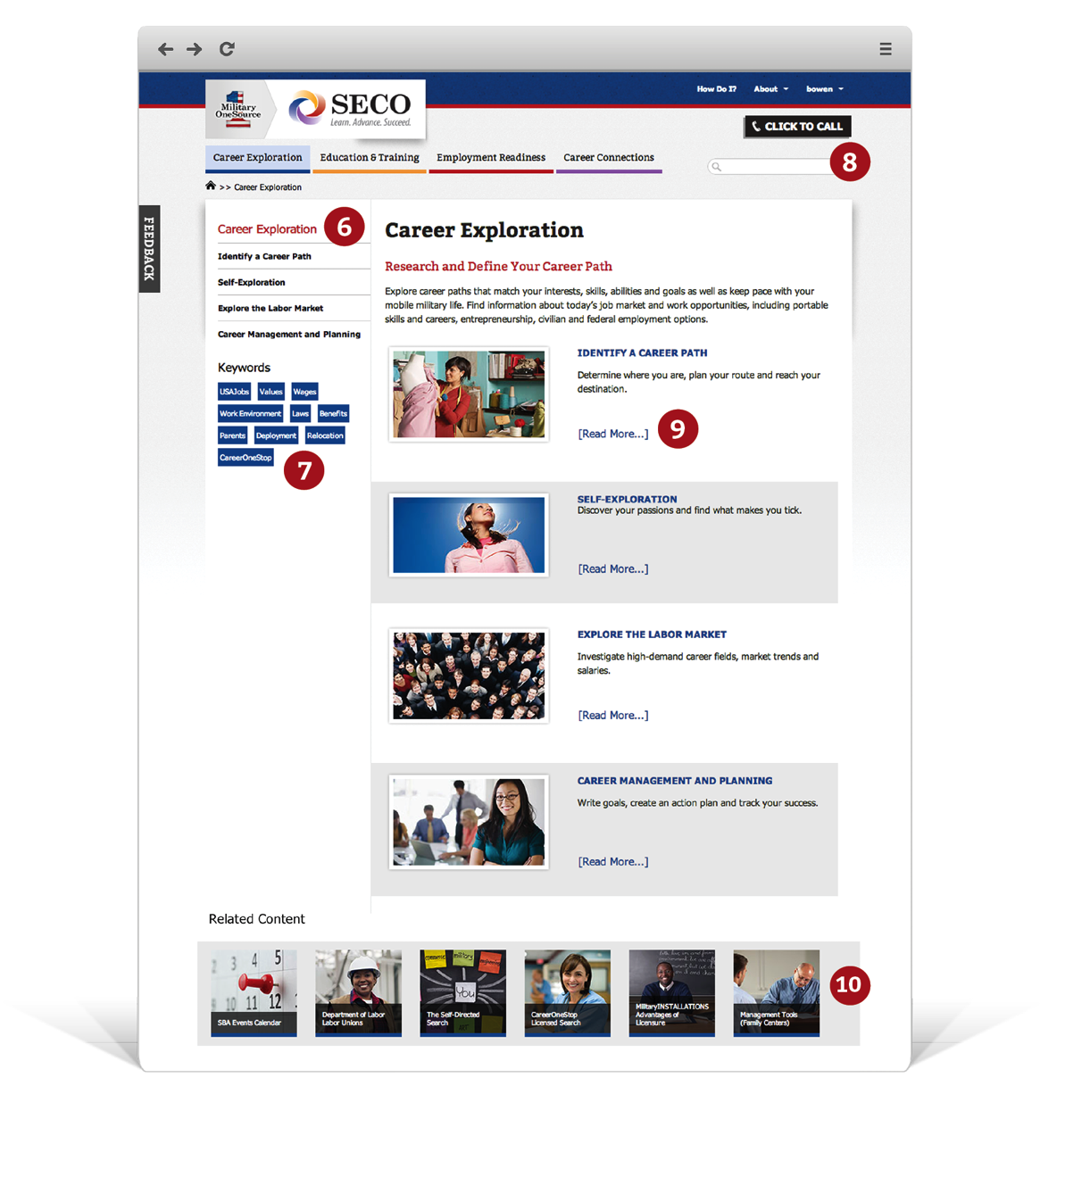
MySECO Web Presence
NEW: MySECO Web Presence and Updates
Includes the following features:
Military Spouse Scholarship Database
LinkedIn integration
Resume builder
Allows spouses to easily research occupations across a wide range of industries
Integrates user feedback
Access
https://myseco.militaryonesource.mil
Mobile website with MySECO QR code Delivered to mobile devices and tablets seamlessly and quickly
Notes:
SECO never stops listening to the needs expressed by military spouses and SECO partners. Because of their valuable feedback, SECO is currently developing the next wave of support services, website functionality and online tools.
The MySECO Web presence features career information, tools and resources.
Spouses can search a Military Spouse Scholarship Database, which features scholarships that spouses may not be aware of, import their LinkedIn profile, build a resume and research occupations.

Slide 10
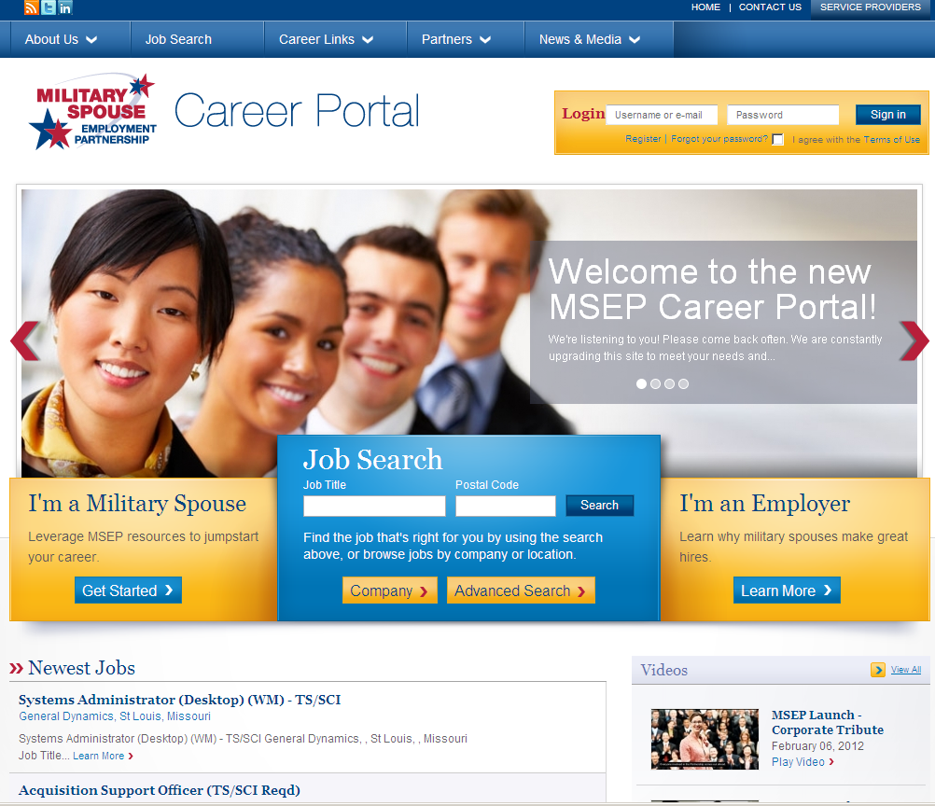
MSEP Career Portal https://msepjobs.militaryonesource.mil
Job search to filter job opportunities
Step-by-step resume builder simplifies creating resumes
Distinct partner profile pages to connect directly with company websites
Resources for spouses and partners
Notes:
When it comes time to find that “dream job,” the MSEP Career Portal is the place to be! For spouses AND employers!
Spouses can search for employers who are participating in the Military Spouse Employment Partnership and link to those companies’ HR landing pages to apply for jobs. MSEP employers want military spouses to self-identify during the job application process, so they can more easily recruit, hire, promote and retain them at time of military relocation.
MSEP partners want to keep military spouses within their corporate family, but when that is not possible, many are referring spouses to other employers for continuity purposes. MSEP employers are offering all types of employment: full time, part time, flexible hours and locations, seasonal work and virtual work opportunities in a full range of occupations.
To date, more than 1.2 million jobs have been posted and more than 50,000 military spouses have been hired.

Slide 11
SECO Support to Spouses and SECO Services
Military OneSource SECO Career Center Counseling
Hiring Our Heroes Career Fairs
Military Spouse eMentoring Leadership Program
Spouse Ambassador Network
MSEP Installation Services Support
Connections for installation employment readiness providers to Hiring Our Heroes and local employment
Connections for installations to MSEP partners
Webinars, training and information for partners and installations
Monthly meetings with military services to develop and steer programming
Notes:
Earlier in today’s briefing, I mentioned that SECO is a “comprehensive” solution to meeting the career needs of military spouses as well as the workforce development and recruitment needs of MSEP partner employers.
Well, here is what we mean by “comprehensive.”
In addition to providing spouses counseling services, spouses and MSEP partners are encouraged to participate in the Hiring Our Heroes hiring fairs sponsored by the U.S. Chamber of Commerce all across the nation, especially the hiring fairs specifically designed for military spouses.
The Spouse Ambassador Network, developed by military spouses for military spouses, reaches the military spouse population directly spreading the word about spouse employment resources.
And critical at the installation level are the employment readiness programs linking spouses to local job fairs, local employers, career-oriented webinars and special spouse events and networking activities right in the communities where they live.

Slide 12
SECO Progress to Date (as of October 1, 2013)
More than 1.3 million employer jobs have been posted on https://msepjobs.militaryonesource.mil since June 29, 2011.
55,000+ spouses have been hired since June 29, 2011 launch of MSEP.
200+ companies are current MSEP partners.
138,000+ military spouses were provided career counseling through the Military OneSource Spouse Career Center in FY13.
Notes:
And here are the amazing results of their efforts:
Over a million jobs have been posted on the MSEP Career Portal since MSEP was launched on June 29, 2011.
More than 50,000 military spouses have been hired.
By the end of 2013, there will be more than 200 companies and organizations in the MSEP Partnership, with more being added every month.
SECO Career Counselors are serving huge numbers of spouses through the call center.
These numbers are expected to continue to grow rapidly in the days ahead, and the SECO Program is prepared to meet that demand with a full array of self-service, peer-to-peer assistance, networking activities and direct services available.

Slide 13
Spouse Ambassador Network
Mission
To educate, empower and mentor military spouses to encourage career fulfillment by promoting and sharing resources while facilitating effective relationships with local and national stakeholders
Notes:
The Spouse Ambassador Network has pledged to help military spouses make the education and career connections that best meet their needs. This “network of networks” is made up of talented, high energy, career minded military spouses who are leading their military support organizations, advocating for military spouses and providing a full range of support services.

Slide 14
Spouse Ambassador Network
The Spouse Ambassador Network has pledged to do the following:
Leverage existing networks of MSEP partners
Share information across multiple platforms
Create a unified message and source of accurate information about SECO and partner resources
Build a foundation from which additional networks can grow
Serve as a potential model for Spouse Ambassador Networks for all family programs
Notes:
The Spouse Ambassador Network has pledged to do the following:
Use the power of their extensive networks to share accurate, timely information from trusted sources regarding key resources and activities designed specifically to support and assist military spouse education and career needs
Use traditional and social media to reach out to military spouses where they live and work
Create a “unified message” about sources of support and information that lead to career success
Help military spouse networks grow
Serve as a potential model for all military family programs

Slide 15
Spouse Ambassador Network
Core group of MSEP partners launched the network and include the following:
Association of the United States Army
Blue Star Families
Business and Professional Women’s Foundation
Hiring Our Heroes (U.S. Chamber of Commerce Foundation)
In Gear Career
Military Officers Association of America
Military Spouse eMentor Leadership Program
Military Spouse Foundation
Military Spouse JD Network
Military Spouse of the Year
Military Spouse Corporate Career Network
National Military Family Association
Spouse Education and Career Opportunities Program
Notes:
Currently, the Spouse Ambassador Network consists of military support organization MSEP partners including the following:
Association of the United States Army or AUSA
Blue Star Families
Business and Professional Women’s Foundation
Hiring Our Heroes (U.S. Chamber of Commerce Foundation)
In Gear Career
Military Officers Association of America or MOAA
Military Spouse eMentor Leadership Program
Military Spouse Foundation
Military Spouse JD Network
Military Spouse of the Year
Military Spouse Corporate Career Network or MSCCN
National Military Family Association or NMFA
Spouse Education and Career Opportunities Program or SECO

Slide 16
Spreading the Word
MSEP Twitter
https://twitter.com/msepjobs
MSEP Facebook
https://www.facebook.com/#!/MSEPOnline
MSEP LinkedIn
http://www.linkedin.com/groups/Military-Spouse-Employment-Partnership-MSEP-4159976
Notes:
Regardless of whether you are a military spouse, partner employer or military support organization, you, too, can help spread the word about SECO support services and the networking activities of interest to SECO participants.
Here are some of the social media links that will keep you connected to the latest, most accurate information currently available.
Information is also posted on other social media:
YouTube
Flickr
Pinterest
Storify
Instagram
Tumblr
And
Military OneSource’s Blog Brigade, Discussion Boards, Webinars, Mobile Websites, Live Chats, Podcasts and Google Hangouts

