Slide 1
Active Duty Spouses and Active Duty Members: Spouse Employment, Satisfaction, Financial Health, Relationships, & Deployments
Results from 2015 Survey of Active Duty Spouses
& 2013-2014 Status of Forces Surveys of Active Duty Members
Malikah Dorvil & Kimberly Williams
Defense Manpower Data Center (DMDC)
Defense Research, Surveys, and Statistics Center (RSSC)

Slide 2
BRIEFING OVERVIEW

Slide 3
RSSC Mission and Surveys
Design, conduct, and analyze Joint-Service surveys for Office of the Under-Secretary of Defense (Personnel & Readiness)
  Provide Department of Defense with accurate assessments of attitudes/opinions of entire DoD community to:
    Evaluate existing programs/policies
    Establish baseline measures before implementing new programs/policies
    Monitor progress of programs/policies and their effects on the Total Force
Standard RSSC surveys include Spouse Surveys and Status of Forces Surveys (SOFS)
  Spouse surveys alternate each year for spouses of AD members and spouses of Guard and Reserve members
  Annual SOFS to active duty (AD), Guard, and Reserve members
  Content includes recurring items, rotating topics, and hot-button items with policy office input

Slide 4
Data and Methodology
Survey | Field Period | Method | Sample Size | Weighted Response Rate
2015 Survey of Active Duty Spouses (ADSS) | Dec 2014– May 2015 | Web & Paper | 45,000 | 24%
2013 & 2014 Status of Forces Survey of Active Duty Members (SOFS-A) | Oct–Dec 2013/ Sep–Nov 2014 | Web | 70,000/ 65,000 | 25%/ 21%
DMDC uses well-established, scientific procedures to randomly select a sample representing the military and spouse populations based on combinations of demographic characteristics
  Demographic groups with lower response rates are oversampled
Data are weighted using an industry standard process to produce survey estimates representative of their respective populations; results can be generalized to full military and spouse populations

Slide 5
BRIEFING OVERVIEW

Slide 6
Employment Status
Percent of All Active Duty Spouses
66% of spouses were in the labor force
MEs ±1% to ±2%
ADSS 2015 Q22-Q24 and Q26

Slide 7
Unemployment Rate
Percent of Active Duty Spouses Who Are in the Labor Force
Unemployed spouses had been looking for work an average of 20.7 weeks (about 5 months)
MEs ±2%
Note: The Unemployment rate excludes spouses of warrant officers and dual military spouses.
Higher response* of Unemployed in 2015 – Army (28%); E1-E4 (30%); Minority (30%); Less Than 26 Years Old (29%); PCS in Past 12 Months (37%); No College (38%); Some College/Vocational Diploma (26%)
Unemployed
Unemployed
MEs±1% to ±4%
MEs ±1% to ±4%
MFLP – Military Family Life Project
ADSS 2015 Q22-Q24 and Q26
* Throughout briefing, only statistically significant findings are reported. Statistical tests are used to compare current estimates with previous results based on unrounded estimates.

Slide 8
Main Reason for Not Looking for Work
Percent of Active Duty Spouses Who Are Not in the Labor Force and Who Selected at Least
One Reason for Not Looking for Work
34% of spouses were not in the labor force
In 2015, highest percentages of spouses of …
O1-O3 (52%) and O4-O6 (51%) members
reported I want to be able to stay home to care for my children
E5-E9 (13%) members
reported child care is too costly
O4-O6 (10%) members
reported I do not want to work
  No significant differences for Service, paygrade, or employment status –
  I am attending school/training, I am preparing for/recovering from a PCS move, I am not physically prepared to work, I stay home to homeschool my children, Other, and I am unable to work while my spouse is deployed
MEs ±1% to ±3%
Note: Other reasons include VISA/work permit, don’t speak English very well, volunteer responsibilities, waiting for start date on a new job, spouse works long hours/shift work, extended family visits overseas, and transportation problems.
ADSS 2015 Q28
MEs ±1% to ±16%

Slide 9
Percent Employed Within Area of Education or Training
Percent of Active Duty Spouses Who Are Employed or Currently Serving in the Military
MEs ±2%
In 2015, highest percentages of O1-O3 spouses (66%) and O4-O6 spouses (68%), Dual Military spouses (62%), and spouses with Graduate/Professional degrees (75%) reported that they are currently employed within the area of their education or training
MEs ±2% to ±5%
MEs ±2% to ±5%
No significant differences between 2012 and 2015
ADSS 2015 Q37

Slide 10
Time Taken To Find Employment After Last Permanent Change
of Station (PCS) Move
Percent of Active Duty Spouses Who Experienced a PCS Move
79% of spouses experienced a PCS move
MEs ±2%
In 2015, higher responses for…
Less than 1 month – Navy (15%); O1-O3 (16%); Employed (13%)
1 month to less than 4 months – Employed (30%)
MEs ±1% to ±2%
10 months or more – Unemployed (47%)
In 2015, no significant differences for Service, paygrade, or employment status –
4 months to less than 7 months and 7 months to less than 10 months
ADSS 2015 Q48

Slide 11
BRIEFING OVERVIEW

Slide 12
Satisfaction With Military Way of Life
Percent of All Active Duty Spouses
MEs ±1% to ±2%
Satisfied
MEs ±1% to ±4%
MEs ±1% to ±4%
Highest percentages of Air Force (68%), E5-E9 (65%), O1-O3 (67%), and O4-O6 (76%) spouses reported being satisfied in 2015
In 2015, highest percentages of E1-E4 (17%) spouses reported being dissatisfied
ADSS 2015 Q89

Slide 13
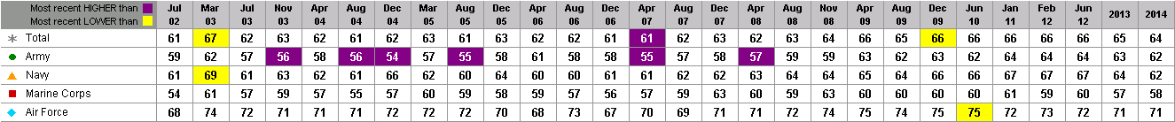
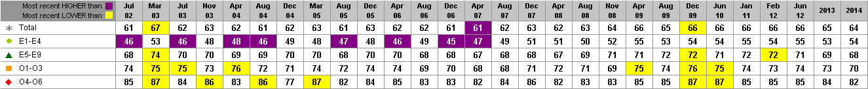
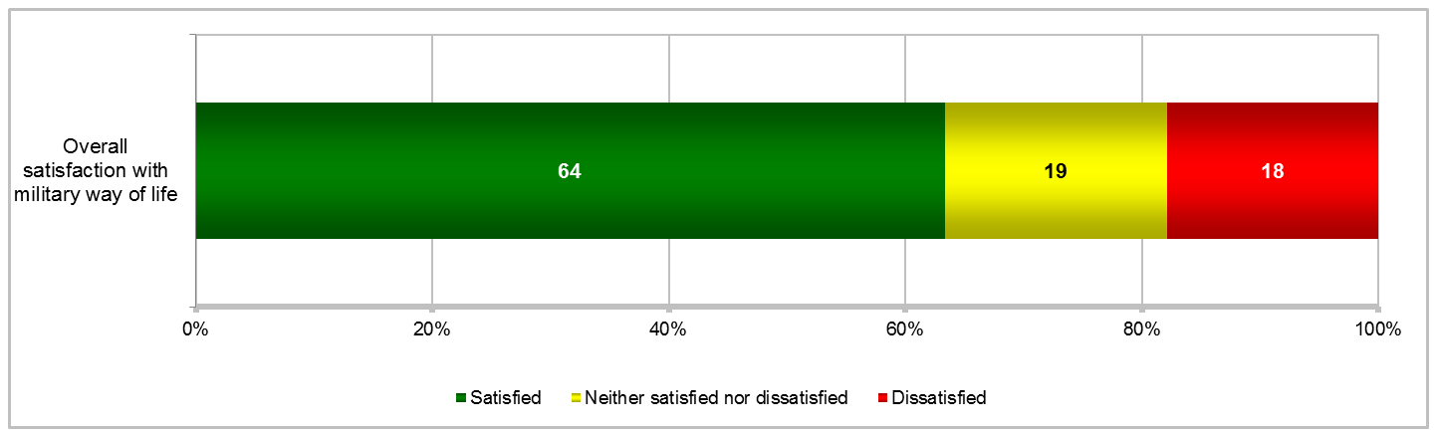
Satisfaction With Military Way of Life
Percent of All Active Duty Members
Satisfied
MEs ±2%
MEs ±1% to ±5%, except Dec 2004 (±3% to ±6%)
MEs ±1% to ±3%, except Dec 2004 (±3% to ±9%)
Highest percentages of Air Force members reported being satisfied (71%) in 2014 vs. other Services
In 2014, highest percentages of Marine Corps members reported being dissatisfied (24%).
Among Enlisted members, Marine Corps (26%) and Navy (21%) were most dissatisfied in 2014.
SOFS-A 2014 Q25

Slide 14
Support To Stay on Active Duty
Percent of All Active Duty Spouses
MEs ±1% to ±2%
Favor staying
MEs ±1% to ±4%
MEs ±1% to ±3%
In 2015, highest percentages of E5-E9 (70%) and O4-O6 (70%) spouses favor their husband/wife
staying on active duty
In 2015, highest percentages of spouses of E1-E4 (26%) and O1-O3 (24%) members
favor their husband/wife leaving active duty
ADSS 2015 Q90

Slide 15
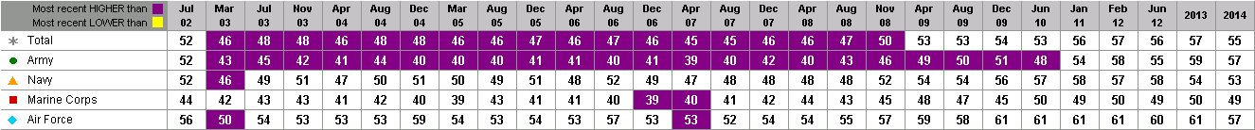
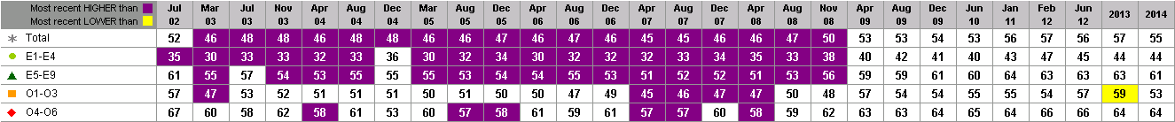
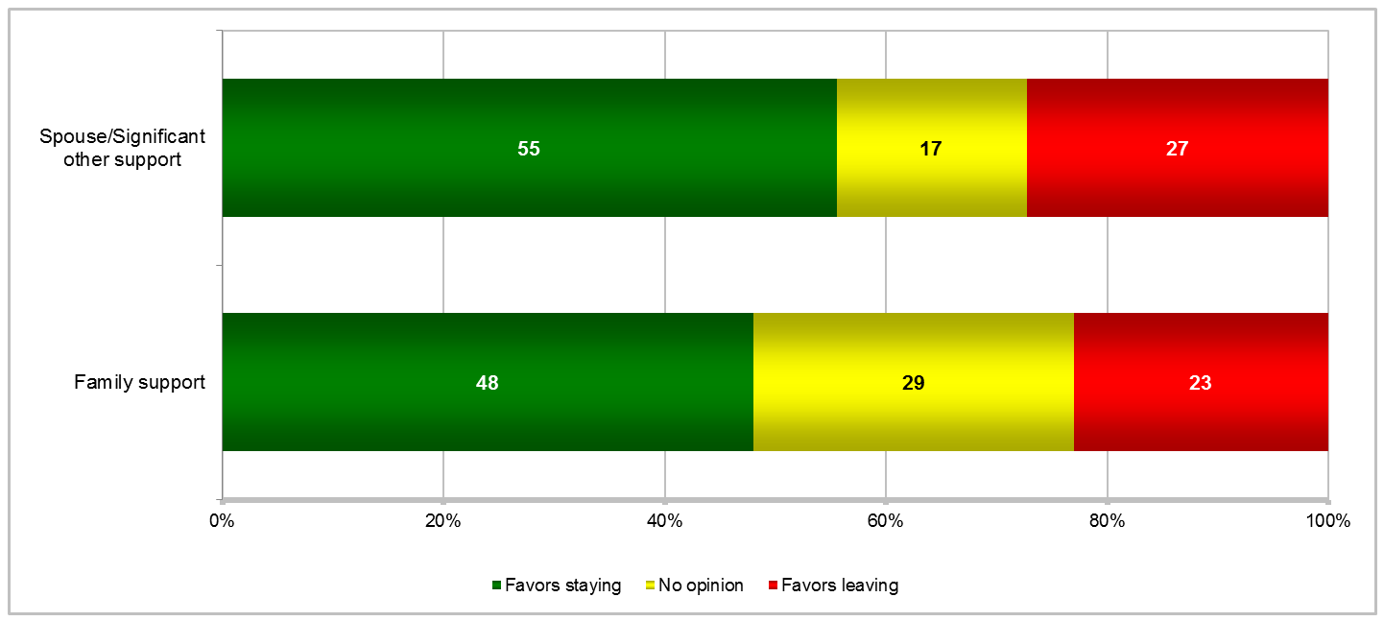
Support To Stay on Active Duty
Percent of Applicable Active Duty Members
Favor staying
MEs ±2%
MEs ±2% to ±5%, except Dec 2004 (±3% to ±6%)
MEs ±2% to ±4%, except Dec 2004 (±3% to ±11%)
In 2014, Marine Corps members had least amount of support to stay from spouse/SO (49%) and family (40%)
Highest percentages of junior Enlisted members’ spouses/SOs reported in 2014 they favor them leaving (32%)
SOFS-A 2014 Q28, Q29

Slide 16
BRIEFING OVERVIEW

Slide 17
Financial Condition
Percent of All Active Duty Spouses
Overall, “comfortable” financial condition in 2015: significantly higher than 2006/2008/2012
MEs ±1% to ±2%
Comfortable
MEs ±1%
MEs ±1%
In 2015, highest percentages of Air Force spouses “comfortable”
In 2015, highest percentages of Army spouses “not comfortable”
ADSS 2015 Q122

Slide 18
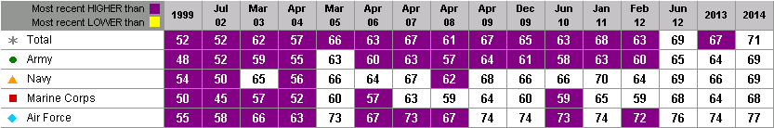
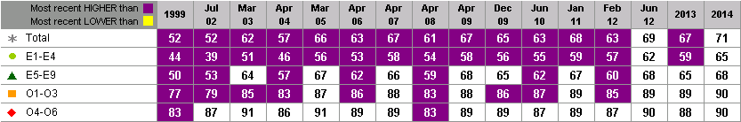
Financial Condition
Percent of All Active Duty Members
Overall, “comfortable” financial condition in 2014: significantly higher than condition since 1999 except Jun 2012
Margins of error (MEs) ±1% to ±2%
MEs
±1% to ±5%
MEs
±1% to ±3%
Among Services in 2014, highest percentages of Air Force members “comfortable” and
Army members “not comfortable”
SOFS-A 2014 Q66

Slide 19
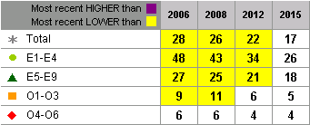
Financial Problems in Past 12 Months
Percent of All Active Duty Spouses
Failed to make minimum payment on credit card account
17% of active duty spouses experiencing any of listed problems
(excludes paying overdraft fees) significantly lower in 2015 vs. 2006/2008/2012
MEs ±1% to ±2%
Most significant improvements
(2015 vs. prior)
Financial problems for…
Marine Corps 11-13 percentage points
Army 8-12 percentage points
E1-E4 8-22 percentage points
E5-E9 3-9 percentage points
MEs ±1%
MEs ±1%
In 2015 among active duty spouses, highest percentages of Army enlisted,
Navy enlisted, and Marine Corps enlisted members’ spouses experienced
any of the listed financial problems (excludes paying overdraft fees)
ADSS 2015 Q123

Slide 20
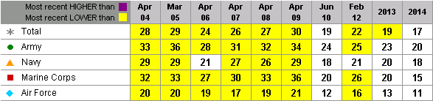
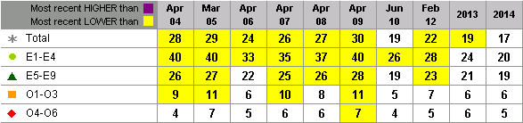
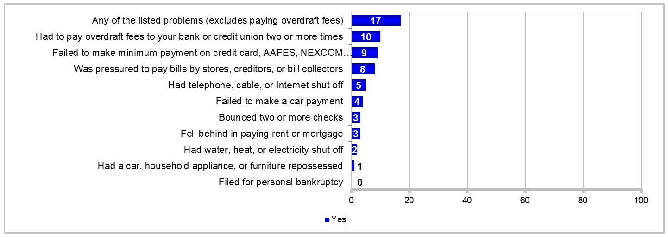
Financial Problems in Past 12 Months
Percent of All Active Duty Members
Failed to make minimum payment on credit card account
17% of members experiencing any of listed problems (excludes paying overdraft fees) significantly lower in 2014 vs. 2004-2009/2012/2013; comparable to 2010
MEs ±1% to ±2%
Most significant improvements
(2014 vs. prior)
Financial problems for…
Marine Corps 11-21 percentage points
Army 5-16 percentage points
E1-E4 6-20 percentage points
E5-E9 4-9 percentage points
MEs ±1% to ±5%
SOFS-A 2014 Q65
MEs ±1% to ±3%

Slide 21
BRIEFING OVERVIEW

Slide 22
Marital Satisfaction
Percent of All Active Duty Spouses
MEs ±1%
Satisfied
Satisfied
MEs ±1% to ±3%
MEs ±1% to ±2%
Higher response of Satisfied in 2015 – Air Force (87%); O1-O3 (89%); Not in Labor Force (87%)
Higher response of Dissatisfied in 2015 – Army (8%); E5-E9 (8%); Employed (8%)
ADSS 2015 Q81

Slide 23
Marital Instability Index (MII)
Average of All Active Duty Spouses
Civilian average score is approximately 1.9
Lower levels of instability
Higher levels of instability
MEs ±0.1
Note: Each item on the MII is scored 0 = No and 1 = Yes (5 items). Overall MII scores are reported as a single figure, which is the sum of the scores across all 5 items (range = 0-5). A higher total score indicates higher levels of instability in the marriage. Civilian average is based on married graduate students (mean = 1.81) and 76 middle class married couples under the age of 55 (mean = 1.89) in Kardatzke, K. N. (2009). Perceived stress, adult attachment, dyadic coping and marital satisfaction of counseling graduate students (Unpublished doctoral dissertation). The University of North Carolina at Greensboro, Greensboro, NC. [Reference: Conger, R. D., Elder, G. H., Lorenz, F. O., Conger, K. J., Simons, R. L., Whitbeck, L. B. et al. (1990). Linking economic hardship to marital quality and instability. Journal of Marriage and the Family, 52, 643-656.]
Instability
Instability
MEs ±0.1 to ±0.2
MEs ±0.1
Higher than average levels of Instability in 2015 – Army (1.5); E5-E9 (1.5); Employed (1.5)
ADSS 2015 Q82

Slide 24
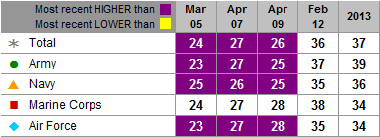
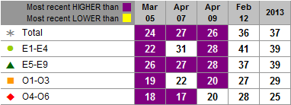
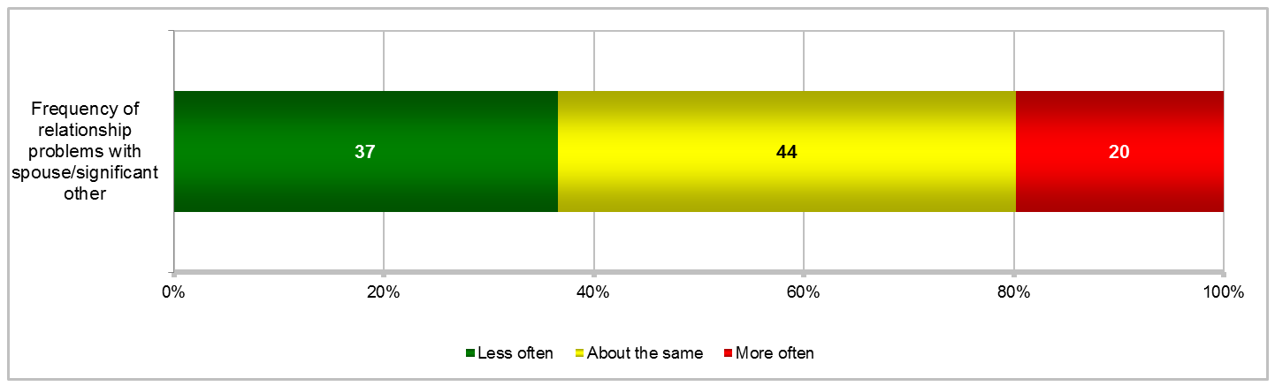
Problems in Personal Relationships Compared to 12 Months Ago
Percent of Active Duty Members Who Had a Spouse/Significant Other
More than 1/3 of members reported problems in personal relationships are occurring less often than 12 months ago
Less often
MEs ±2%
In 2013, highest percentages of Army enlisted members (42%) reported having problems less often, while highest percentages of Navy enlisted members (25%) reported having problems more often
2013 results for Total, all Services, and all paygrade groups comparable to 2012 results
MEs ±2% to ±6%
Most significant improvement (problems less often) – Army members (12-16 percentage points better in 2013 vs. 2005-2009)
Among paygrade groups, E1-E4 members reported most significant improvement in 2013 (17 percentage points higher) vs. 2005
MEs ±2% to ±5%
SOFS-A 2013 Q91, Q92

Slide 25
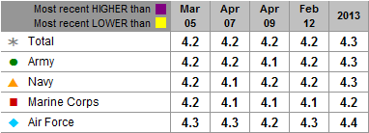
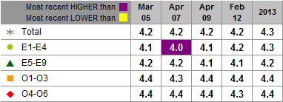
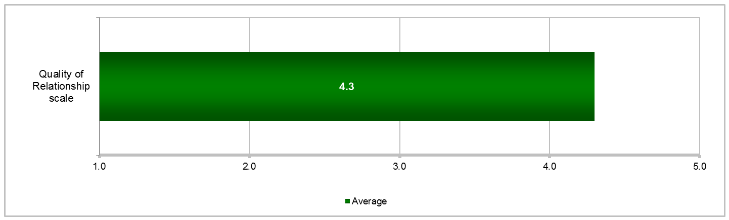
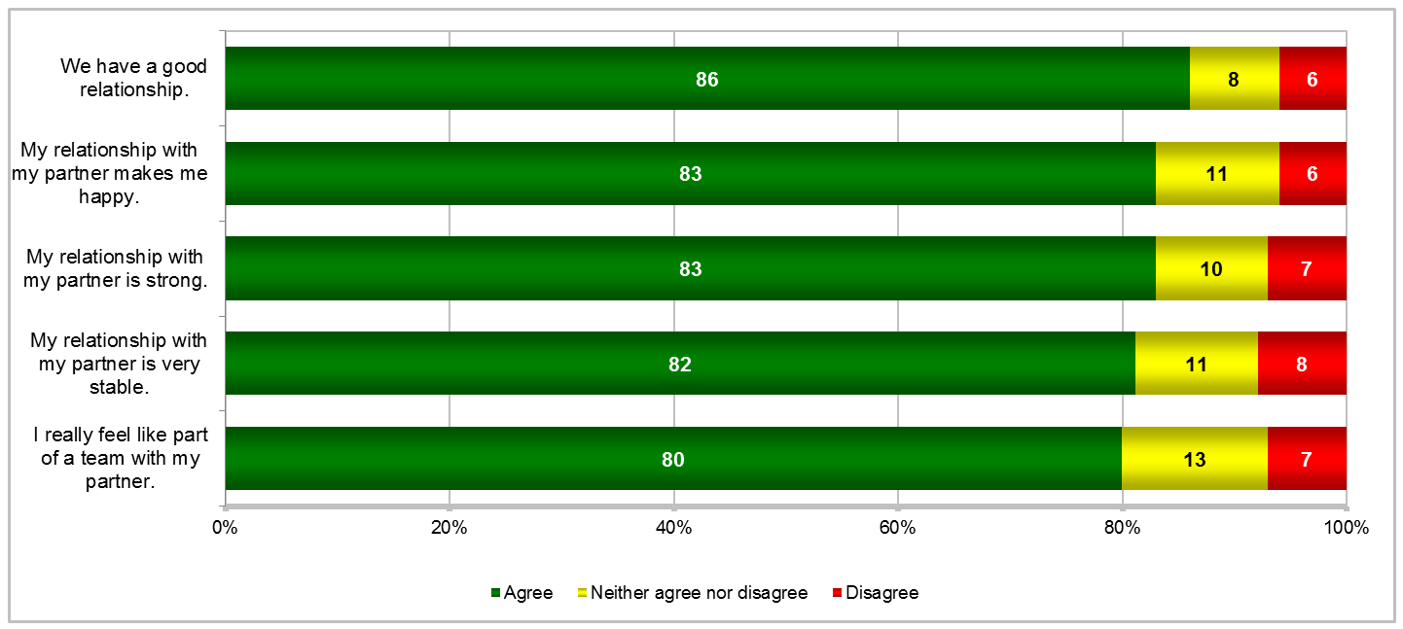
Relationship with Spouse/Significant Other
Percent of Active Duty Members Who Were Married or Separated or Had a Significant Other
MEs ±1% to ±2%
Quality of Relationship
MEs ±0.1 to ±0.2
MEs ±0.1
No significant differences in Quality of Relationship for Total and Services in 2013 vs. 2005-2012
SOFS-A 2013 Q93
MEs ±0.1

Slide 26
BRIEFING OVERVIEW

Slide 27
Problems During Most Recent Deployment
Percent of Active Duty Spouses Whose Husband/Wife Had Been Deployed
Large Extent
MEs ±1% to ±2%
Loneliness – Navy (34%); E1-E4 (43%); Unemployed (39%)
Being a “single” parent – No differences for Service, paygrade, or employment status
Dealing with issues/decisions alone – Navy (23%); E1-E4 (25%); Unemployed (25%)
Technical difficulties communicating w/ spouse – Navy (24%); E1-E4 (28%); Employed (21%)
Difficulty maintaining emotional connection w/ spouse – Army (21%)
Emotional problems in family – E1-E4 (22%); E5-E9 (19%); Unemployed (25%)
Managing child care/child schedules – E5-E9 (16%); Employed (17%)
Note: The response options were not the same across the surveys which may account for some of the differences across years.
MEs ±1% to ±12%
ADSS 2015 Q104
In 2015, improvements in extent of each listed problem during most recent deployment

Slide 28
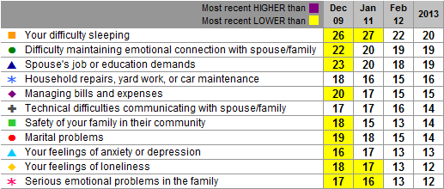
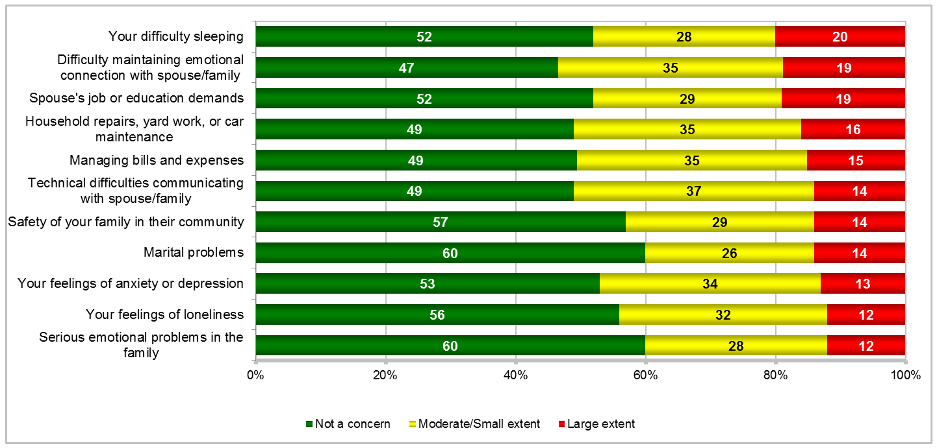
Concerns While Away During Most Recent Deployment
Percent of Applicable Active Duty Members Deployed Since 9-11-01
MEs ±1% to ±3%
Large Extent
Improvements in percentages of members reporting 9 of 11 concerns in 2013 vs. 2009/2011
Most significant improvement in difficulty sleeping (6-7 percentage points lower in 2013)
In 2013, Army enlisted members reported higher response of large extent for difficulty sleeping (27%), managing bills and expenses (18%), technical difficulties communicating with spouse/ family (18%), and feelings of anxiety/depression (17%)
SOFS-A 2013 Q161
MEs ±1% to ±3%

Slide 29
Changes in Husband/Wife After Return Home
Percent of Active Duty Spouses Whose Husband/Wife Returned From Deployment
MEs ±1% to ±2%
Large Extent
Appreciate family and friends more – Army (24%); E1-E4 (28%); Not in Labor Force (25%)
Appreciate life more – Army (23%); Not in Labor Force (23%)
Have trouble sleeping – Army (24%); E5-E9 (20%); Employed (19%)
More emotionally distant – Army (21%); E1-E4 (20%); Employed (17%)
Get angry faster – Army (23%); E1-E4 (20%); E5-E9 (17%)
Show negative personality changes – Army (18%); E5-E9 (14%); Employed (16%)
Have mental health concerns – Army (19%); E5-E9 (14%)
Note: The response options were not the same across the surveys which may account for some of the differences across years.
MEs ±1% to ±15%
ADSS 2015 Q114

Slide 30
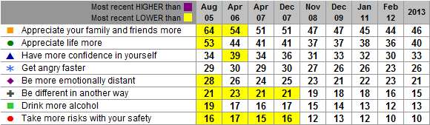
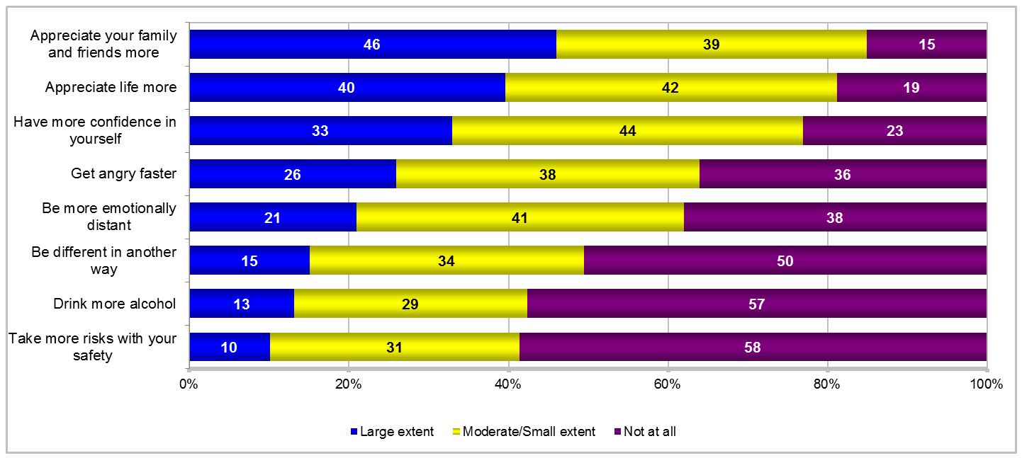
Emotional/Behavioral Changes After Deployment
Percent of Active Duty Members Deployed in Past 24 Months but Not Currently Deployed
MEs ±3% to ±4%
Note: “Be different in another way” responses include appreciate Service members more, be less social, get too little sleep, focus more on physical fitness, be more social, be tired or have less energy, appreciate things previously taken for granted, and be more stressed or hypervigilant.
Large Extent
Percent reporting positive emotional/ behavioral changes significantly lower in 2013 than 2005/2006 but comparable to 2007-2012
Improvements in 4 of 5 negative emotional/behavioral changes in 2013 vs. 2005-2007
SOFS-A 2013 Q162
MEs ±2% to ±4%

Slide 31
Spouse's Readjustment to Member's Return From Deployment
Percent of Active Duty Spouses Whose Husband/Wife Returned From Deployment
MEs ±2%
Higher response of Easy in 2015 – Air Force (62%); Not in Labor Force (58%)
Higher response of Difficult in 2015 – Army (22%); Employed (21%)
Difficult
Difficult
MEs ±1% to ±6%
MEs ±1% to ±5%
Most significant decreases (improvements) in difficult readjustments for spouses of Army and Marine Corps members (both 11 percentage points lower in 2015 vs. 2008) and E1-E4 members (15 percentage points lower in 2015 vs. 2008)
ADSS 2015 Q116

Slide 32
Member's Reconnection With Child(ren) After Deployment
Percent of Active Duty Spouses Who Had Child(ren) During the Member's Most Recent Deployment and Whose Husband/Wife Returned From Deployment
MEs ±2%
Higher response of Easy in 2015 – Air Force (77%)
Higher response of Difficult in 2015 – Army (14%); Employed (13%)
Difficult
Difficult
ADSS 2015 Q115
MEs ±1% to ±3%
MEs ±1% to ±5%

Slide 33
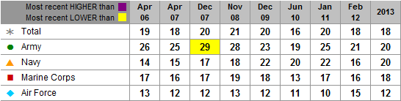
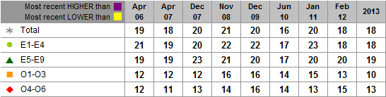
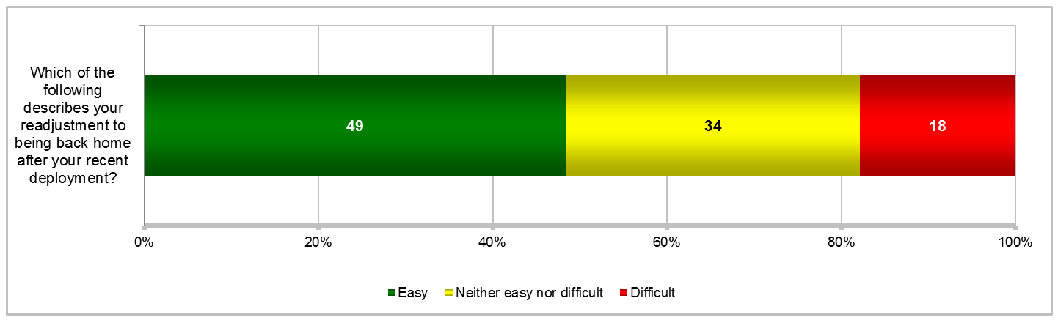
Degree of Difficulty in Readjusting to Return Home
Percent of Active Duty Members Deployed in Past 24 Months but Not Currently Deployed
MEs ±3% to ±4%
Difficult
No significant differences in difficult readjustment to being back home in 2013 vs. 2006-2012 except Army members (9 percentage points lower in 2013 vs. Dec 2007)
In 2013, highest percentages of Air Force members reported easy readjustment (59%),
MEs ±2% to ±11%
while lowest percentages of Army members reported easy readjustment (43%)
In 2013, 19% of Enlisted members reported a difficult readjustment
compared to 13% of Officers who reported a difficult readjustment
SOFS-A 2013 Q166
MEs ±2% to ±7%

Slide 34
"How well did this child..."
Percent of Active Duty Spouses Who Selected a Child Living at Home During Husband/Wife's
Most Recent Deployment
MEs±2%
Poorly
MEs ±2% to ±8%
Higher response of Well
Coped with your spouse’s deployment – O4-O6 (65%)
Stayed connected to your spouse given deployment separations – Air Force (73%)
Higher response of Poorly
Coped with your spouse’s deployment – No differences for Service, paygrade, or employment status
Stayed connected to your spouse given deployment separations – Navy (17%)
ADSS 2015 Q110

Slide 35
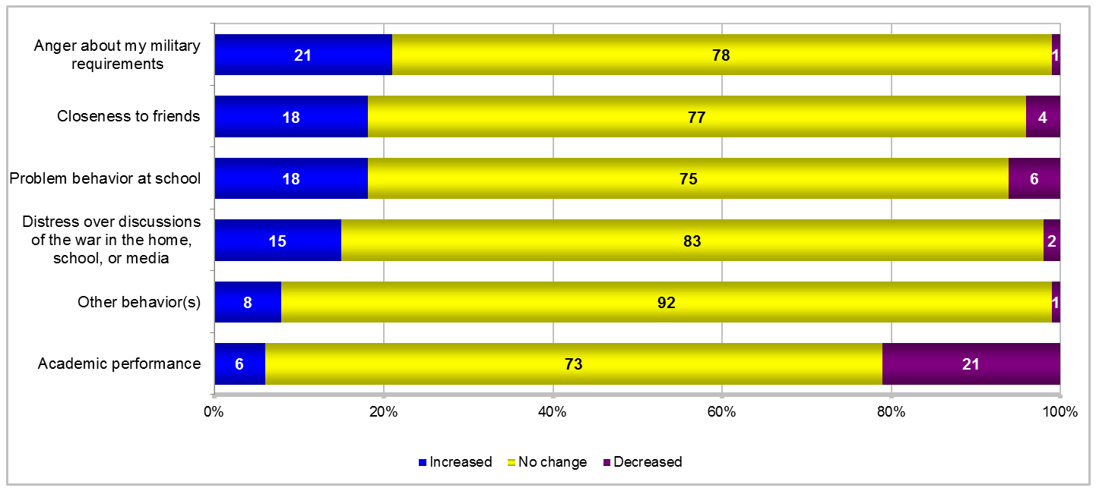
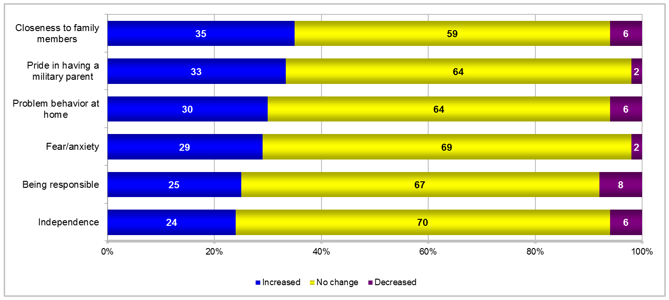
Children's Emotional/Behavioral Changes in Response to Deployment
Percent of Active Duty Members Deployed in Past 24 Months but Not Currently Deployed and Who Had at Least One Child During Most Recent Deployment
10 percentage points vs 2009
Significant decreases (improvements) for 4 negative emotional/ behavioral changes in 2013 vs. 2006-2009
9-12 percentage points vs 2006-2007/2009
No significant differences for 8 of 12 emotional/ behavioral changes in 2013 vs. 2006-2012
8 percentage points vs 2006-2007/2009
6 percentage points vs 2006-2007
Note: “Other behavior(s)” include night terrors, disobedience towards adults, isolation, less attentive at school, and increased aggression.
MEs ±2% to ±6%
SOFS-A 2013 Q168

Slide 36
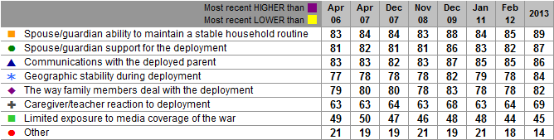
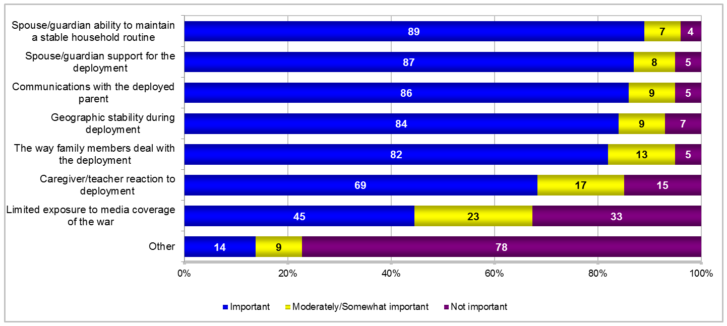
Importance of Factors for Children in Coping With Deployments
Percent of Active Duty Members Deployed Since 9-11-01 With Children Age 22 or Under and Who Had at Least One Child During Most Recent Deployment
Note: “Other” responses include support from church, involvement in extracurricular activities, spending time with other family members, providing children with member’s definite return date, having defined family roles, and member taking mid-tour leave.
MEs ±3% to ±6%
Important
No significant differences in importance of factors in 2013 vs. 2006-2012
Army enlisted members in 2013 reported higher percentages of importance for caregiver/ teacher reaction to deployment (78%) and limited exposure to media coverage of war (55%)
SOFS-A 2013 Q169
MEs ±2% to ±6%

Slide 37
BRIEFING OVERVIEW

Slide 38
Summary of Results
Spouse unemployment rate lower* in 2015 vs. 2010 (MFLP) but higher vs. 2006/2008
About two-thirds of active duty (AD) spouses (2015) and AD members (2014) satisfied with military way of life overall – spouse satisfaction higher than 2006/2008; member satisfaction generally steady from 2002-2014
Almost three-quarters of AD spouses and AD members reported “comfortable” financial condition – higher than 2006-2012 (AD spouse) and 1999-Feb 2012/2013 (AD member)
85% of AD spouses satisfied with their marriage in 2015; marital instability index lower in 2015 (indicating more stability) than in 2012
Problems in AD members’ personal relationships occurring less often than 12 months ago – improvement in frequency in 2013 vs. 2005-2009 and comparable to 2012
Problems experienced by AD spouses during their husband’s/wife’s most recent deployment and AD members’ positive and negative changes following return from deployment lower in 2015 compared to 2006/2008/2012
Spouses reporting difficult readjustment to member's return from deployment lower in 2015 vs. 2006/2008 and comparable to 2012
Bottom Line: Overall satisfaction, financial condition, and marital satisfaction generally improved for AD spouses and AD members compared to previous results. Lower percentages of AD spouses and AD members experienced problems during and after deployments than in previous years.
* Only statistically significant findings are reported. Statistical tests are used to compare current estimates with other subgroups and previous results based on unrounded estimates.

Slide 39
  Questions?
  Contact information
  Dr. Paul Rosenfeld: Division Director, DMDC-RSSC, paul.rosenfeld.civ@mail.mil
  Ms. Carol Newell: Branch Chief, DMDC-RSSC, carol.e.newell2.civ@mail.mil
  Ms. Malikah Dorvil: Survey Analyst, DMDC-RSSC, malikah.j.dorvil.civ@mail.mil
  Ms. Kimberly Williams: Survey Analyst, DMDC-RSSC, kimberly.g.williams6.civ@mail.mil
  Dr. Cathy Flynn: Senior Program Analyst, MC&FP, cathy.a.flynn.civ@mail.mil
    DMDC Website (https://www.dmdc.osd.mil/appj/dwp/dwp_surveys.jsp)

